Slide 1
Identifying Community Level Factors Associated with Microenterprises
Todd Greene
June 17, 2014

Slide 2
Disclaimer
The views expressed in this presentation are the views of the speaker and do not necessarily reflect the views or policies of the Federal Reserve Bank of Atlanta or the Federal Reserve System.

Slide 3
Outline
Labor market trends
Micro-businesses as a potential alternative to formal employment
Impact of micro-businesses on local economic performance
Attributes of communities with strong micro-business presence
Implications

Slide 4
Unemployment Since 2004
Source: Bureau of Labor Statistics

Slide 5
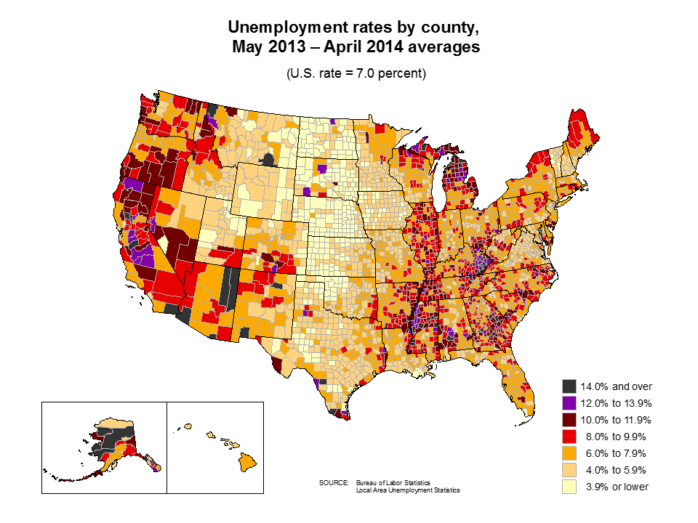
Source: Bureau of Labor Statistics
Notes:
Please note that this a one year average rate, not for August 2012

Slide 6
LT unemployed job finding has not improved much since the recession
Source: CPS Microdata, Author's Calculations
Notes:
<5 wks: declined 7.8%pt, 69% recovered
5-14wks: declined 7.9%pt, 54% recovered
15-26wks: declined 7.8%pt, 47% recovered
27-51wks: declined 7.8%pt, 26% recovered
52+wks: declined 4.5%pt, 40% recovered

Slide 7
But long-term unemployed have become more likely to only get PTER work
Source: CPS Microdata, Author's Calculations

Slide 8
Reasons for not participating varies by age – e.g., disability is concentrated in pre-retirement ages
Sources: Current Population Survey, Author's Calculations
Notes:
With respect to disability, most of the recent increase appears to be a change in behavior: ¼ due to more people in pre-retirement ages with high disability rates and ¾ due disability rates within pre-retirement ages

Slide 9
Self-employment or micro-businesses may be a viable alternative for long-term unemployed
Over time, more people in the U.S. have turned to self-employment as a source of income
The long-term trend in the self-employment data has revealed a remarkable labor market phenomenon in the U.S.
More and more people seem to be choosing self-employment as an alternative or supplement to formal labor market
Surge in self-employment is likely to continue

Slide 10
Self-Employment (Non-Farm Proprietorships) and Wage-and-Salary Employment, 1969-2009
Self- employment
Wage-and-salary employment
Notes:
The nonfarm proprietorships consist of the number of sole proprietorships and the number of individual general partners (the Bureau of Economic Analysis).
Sole proprietorships.—Income from a nonfarm sole proprietorship is reported on Schedule C—Profit, or Loss, from Business or Profession—of Internal Revenue Service (IRS) Form 1040—U.S. Individual Income Tax Return.
Partners.—Based on IRS Form 1065—U.S. Partnership Return of Income.

Slide 11
Share of Self-Employment as a Percent of Wage-and-Salary Employment, 1969-2009

Slide 12
Most of these self-employed are engaged in micro-businesses
They are the smallest of small businesses
A sole proprietorship, partnership or family business that has fewer than five employees (Aspen Institute and the Association for Enterprise Opportunity)
Includes businesses with no paid employees
In the U.S., microenterprises (establishments with less than 5 employees) were around 89 percent of all enterprises in 2010
They provide 17-20 percent of nonfarm employment
Notes:
Nonemployers: no paid employees, has annual business receipts of $1,000 or more ($1 or more in the construction industries), and is subject to federal income taxes

Slide 14
Source: Bureau of the Census: County Business Patterns

Slide 15
Micro-business is Already a Local Economic Development Tool
Embedded in economic development entrepreneurship strategies:
“Development from below”
“Bottom-up development”
“Economic gardening”
“Growing of your own”
For some, favoring local micro-businesses or self-employment is believed to be better for local development

Slide 16
Micro-Business Assistance Programs
Have grown from only a few in 1985 to 696 programs in 2008
A total of 274,128 individuals received services from microenterprise providers in FY08
Lending activity by the 362 programs identified as micro-lenders :
made an estimated 9,191 loans totaling $100,912,050 in FY 2008
held an estimated $173,637,960 in outstanding loans, and
held an estimated total of $ 235,282,605 in their microloan capital pools.
Source: Aspen Institute. U.S. Microenterprise Census Highlights FY2008 Data

Slide 17
Rationale for Micro-Business as an Economic Development Strategy
Generator of long-term sustainable jobs
More likely adaptable to changing conditions (less capital intensive)
Potential tool to alleviate poverty
Income patching
Increased overall community economic activity/ vitality

Slide 18
Recent Research on Effects of Microenterprises / Self-Employment on Local Economies
Study | Measure of entrepreneurship | Geography | Measure of economic performance
Deller and McConnon (2009) | Establishments that employs 1-4 employees (County Business Patterns data from the Census Bureau) | US States | Employment and income growth
Goetz et al (2011) | Kauffman Entrepreneurship Index (KEI) | US States | Employment growth
Rupasingha and Goetz (2011) | The share of nonfarm proprietorships (Bureau of Economic Analysis data) | US Counties | Employment and income growth and change in poverty
Notes:
The KEI is the share of adults starting a new business in the previous month, as collected in the March Current Population Survey.
Deller, S., and J. J.C. McConnon. 2009. "Microenterprises and economic growth: a panel study of the US states 1977–1997." Applied Economics Letters 16(13):1307-1312.
Goetz, S.J., M.D. Partridge, D.S. Rickman and S. Majumdar (2011), “Sharing the Gains of Local Economic Growth: Race to the Top vs. Race to the Bottom Economic Development.” Environment and Planning C: Government and Policy. 29(3): 428-456
Rupasingha, A. and S.J. Goetz (2011), “Self-Employment and Local Economic Performance: Evidence from US Counties,” Papers in Regional Science, doi:10.1111/j.1435-5957.2011.00396.x.

Slide 19
Summary of Research Findings
Entrepreneurship is favorable for state income and employment growth
Self-employment has a strong favorable impact on income and employment growth in both metro and nonmetro counties
Self-employment helps reduce poverty in nonmetro counties

Slide 20
Recent Research - Effect of Locally-Owned Micro-Businesses
Fleming and Goetz (2011): Locally owned micro-businesses (1-9 employees) are favorable for county income growth, compared to nonlocal businesses
Rupasingha (2012): Locally owned micro-businesses (1-9 employees) create more employment opportunities and help reduce poverty in local communities, compared to larger businesses

Slide 21
Opportunities for Policy and Practice
It is important to know what is needed for micro-businesses to be successful
Individual level factors
Community level factors
Understanding these factors may facilitate the development of appropriate policies at the local level
Some communities have a higher rate of micro-businesses than others
This creates an opportunity for researchers to study community level factors that are associated with higher rates of micro-businesses

Slide 22
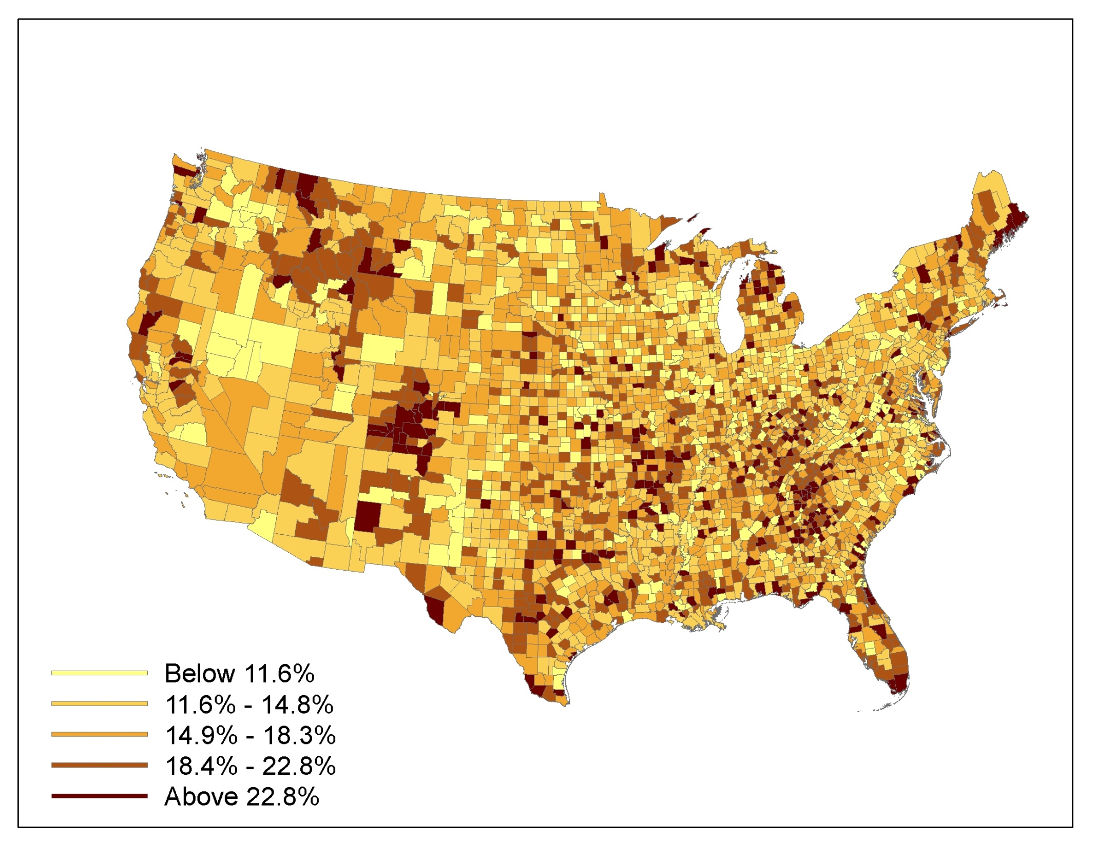
Spatial Variation of Microenterprises (with 0-4 employees) in the U.S., 2007
Spatial Variation of Microenterprises (1-4 Employers) in the U.S., 2007
Data source: U.S. Bureau of the Census
22
Notes:
Map shows all microenterprises (0-4 employees) per hundred employed people in a county
Calculation was done to take into consideration the size of a county in terms of labor force.
Total number of microenterprises were divided by number of employed labor force and multiplied by 100. So % number is number of micro-businesses per hundred employed people in a county.
The map shows that some counties have more micro-businesses than other counties
This variation may be due to multiple reasons and recent research at Atlanta Fed makes an effort to understand some of these reasons
(This research is currently limited to studying factors associated with micro-businesses that have 1-4 employees)
Results are generalized for all counties in the U.S. They may differ for specific regions of the country or rural vs. urban counties

Slide 23
Characteristics of Micro-business Friendly Communities: Access to Capital
Higher home ownership and median housing values are associated with higher rates of micro-businesses in a county
Higher number of bank branches in a county is associated with higher rates of micro-businesses in a county
Higher amounts of Community Reinvestment Act (CRA) loans (less than $100,000 loans) are associated with higher rates of micro-businesses in a county
Notes:
Home ownership and median housing values are considered as collaterals to obtain loans from banks
More bank branches leads to higher competition, resulting in more loans
CRA is supposed to help small businesses. Results indicate that smaller loans by the banks reported under CRA may have a positive impact on micro-businesses

Slide 24
Characteristics of Micro-business Friendly Communities : Economic/Labor Force Factors
Lower wage and salaries from formal employment are associated with higher rates of micro-businesses in a county
Higher unemployment rates are associated with higher rates of micro-businesses in a county
The bigger the size of the local market (measured by total personal income), the higher the rate of micro-businesses in a county
Notes:
Lower wages pushes people to self-employment; lower wages also an incentive for business start-ups
Unemployment (especially long-term) pushes people to start their own businesses
Bigger markets provide more opportunities for small businesses. Alternatively you could argue that smaller markets may have more micro-businesses because there aren’t very many big businesses providing services in these communities

Slide 25
Characteristics of Micro-business Friendly Communities: Demographic Characteristics
The more the college graduates in a county, the higher the rate of micro-businesses
Micro-business rate in a county tend to rise with median age
Counties with higher shares of married households have higher rates of micro-businesses
Counties that have higher shares of African Americans have higher rates of micro-businesses
Notes:
The age has been used as a proxy for experience in previous studies
Married households: one reason may be due to micro-businesses being family businesses. Another argument is that less amount of shirking is observed when family members are employed vs. paid labor
African Americans: arguments have been made that in general, minorities tend to have their own businesses due to discrimination in the formal labor market. But surprisingly, Hispanic variable is not significant in the model.

Slide 26
Characteristics of Micro-business Friendly Communities : Natural Amenities
Natural amenities index: lakes, rivers, beaches, mountain, open spaces, mild temperatures, etc
This index is favorably associated with rate of micro-business in a county
Higher natural amenities => more micro-businesses
High amenity areas are attractive for most people (they don’t want to leave even after a lay off)
High amenity areas also attract businesses from outside including micro-businesses
Notes:
Study uses USDA natural amenities index

Slide 27
Ideas for Practice: Help for Micro-Businesses
Technical assistance to increase productivity
Help with business plans and marketing
Promote general business services
Provide programs that stimulate the entrepreneurial culture of a community
Policy change with respect to issues such as healthcare, taxation
Help with access to capital

Slide 28
Micro-business: General Implications for Practice
Alignment with workforce development efforts and perhaps targeted toward populations facing stubbornly high unemployment
More recognition of micro-businesses as an income patching strategy for local economies
Potential to improve farm and nonfarm earnings in rural communities
Potential to decrease population loss in rural communities
Potential employment opportunities for women

Slide 29
Thank You!
News You Can Use from the Atlanta Fed:
Partners Update…the latest new from the Federal Reserve System and community and economic development efforts in the southeast…www.frbatlanta.org/pubs/partnersupdate/
The Human Capital Compendium…a collection of all resources from the Federal Reserve System on employment and workforce development…www.frbatlanta.org/chcs/compendium/
Podcasts…hear from national experts on what’s working in economic development, foreclosure response, and other topics…www.frbatlanta.org/podcasts/

