Slide 1
Preparing for a Buyer Meeting
Award Winning Indian Foods

Slide 2
Agenda
Research and Prepare for the opportunity
Pitfalls to Avoid
Meeting tips
Some examples

Slide 3
Research
Visit the Store – Study the Category
Product Mix
Pricing
Placement
Promotion
Distribution options to the Store- connect with potential distributors and brokers

Slide 4
Prepare
What Product(s)?
Why should the buyer care?
Demand for your category?
Demand for your Product(s)?
Why is it different from what is there?
How will it get there? (Warehouse? Distributor?)
Pricing
Where should it be Placed for success?
Promotion- How will you build your consumer base?

Slide 5
Pitfalls to avoid - Costing
COGS
(food cost +labor+overheads)
Your profit
Broker $
Retailer Markup
Distributor $
Freight?
Retailer Promo
Distributor Program

Slide 6
Pitfalls To Avoid:
Packaging
How much should you pack per case?
Big enough for application
Small enough to provide adequate turnover in distribution
Format of package?
- Dry, Refrigerated or Frozen

Slide 7
Before the Meeting
Know your numbers
Your Costs (production, warehousing, shipping)
Distributor Costs (spoilage, marketing)
Retailer Costs (Slotting, promotion, spoilage)
Know your consumer (is it at this retailer?)
Know the Value proposition – (why are you so special?)
Be prepared to prove it
Data
Tasting
Education

Slide 8
Take with you
A short presentation with key data points
Company, Product, Value Prop, Pricing, Ranking & Specs
Launch Date – ready to ship?
Samples – ready to taste – buyer has 20 minutes…
All paperwork – Retailer & Distributor
Your story, passion and energy- Buyer’s look forward to it

Slide 9
Meeting Tips
Be early.
Be prepared.
Put the best person forward – You!
Propose your product and program with confidence. You know your product!

Slide 10
Pitfalls To Avoid:
Signing up for too much!
Scale with quality in mind
Reputation/Brand is at stake
Profitability at stake

Slide 11
Product Info Template-example
Frozen
Maximum Delivered Unit Cost To Distributor: $X.XX
Maximum Unit Cost : $X.XX
Suggested Retail Price (everyday) : $5.99
Everyday Gross Margin % (everyday): 41%
Promotional Support Program: 2 months Exclusive, we offer a scanback of 70 cents a unit, to hit holiday retail price of $4.50 with 38.5% margin
Exclusivity YES – 60 days
Appeals to the Gluten Free lifestyle
Ethnic Cuisine in the format America likes to eat
Made in the USA by a family owned and operated minority business.
The best thing to happen to appetizer door in years
Vendor Contact Information (Manufacturer Company, Name, Email, Phone)

Slide 12
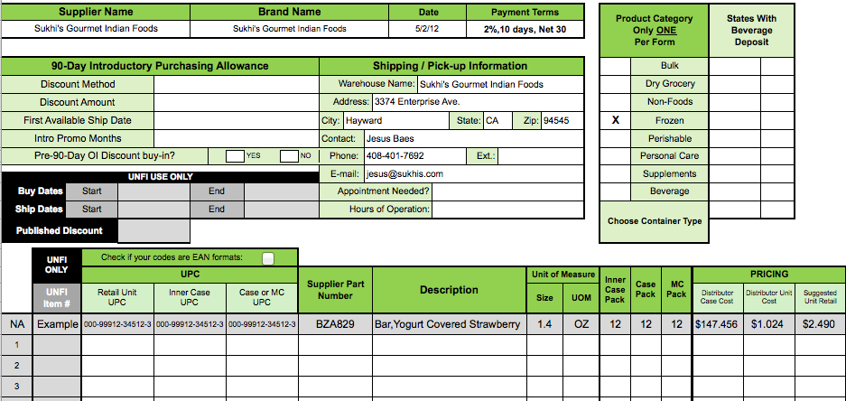
New Item form –example
Details, details details….

Slide 13
Spec Sheet-example

Slide 14
Questions?
Sanjog Sikand – sanjog@sukhis.com

