Slide 1





Think Like A Negotiator
Eldonna Lewis Fernandez
MSgt USAF Retired
As Featured On/In
Notes:
Shredder Story

Slide 2

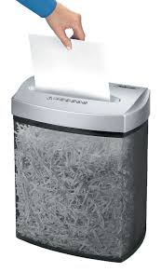
Paper Shredder

Slide 3
Today:
  Background and Experience
  7 Common Negotiating Mistakes
  How You can Easily Become a Better Negotiator

Slide 4
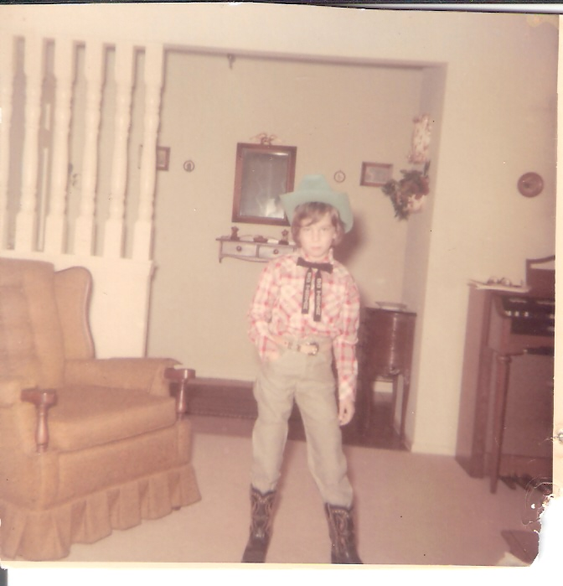
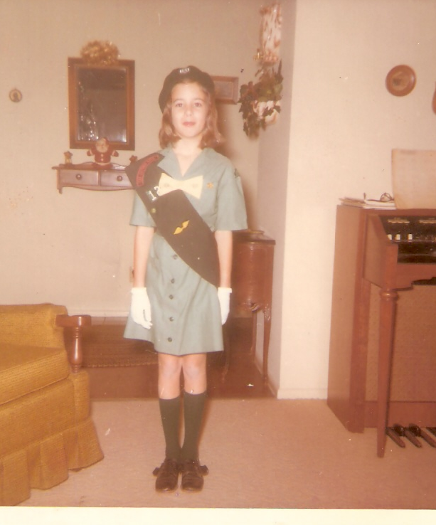

Slide 5
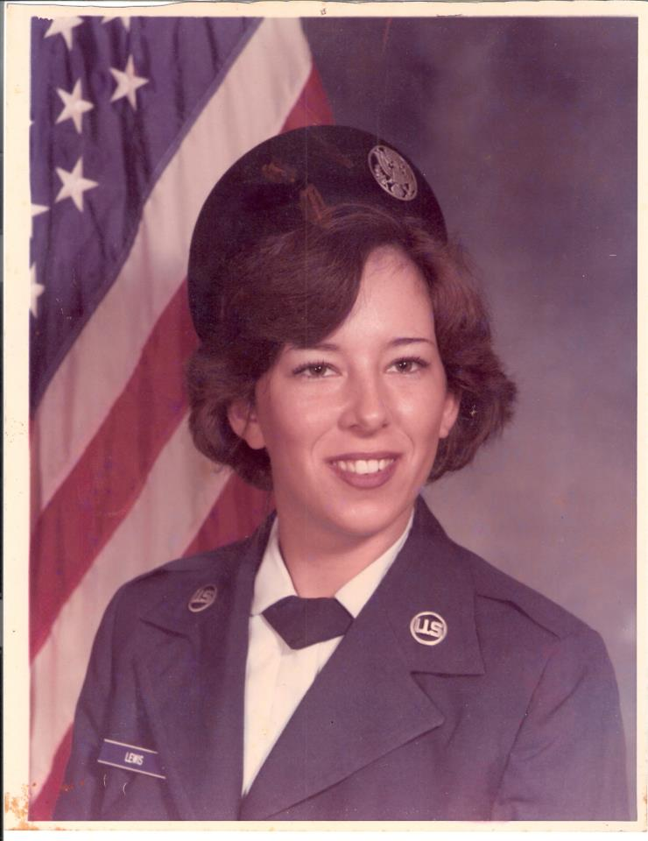


Slide 6
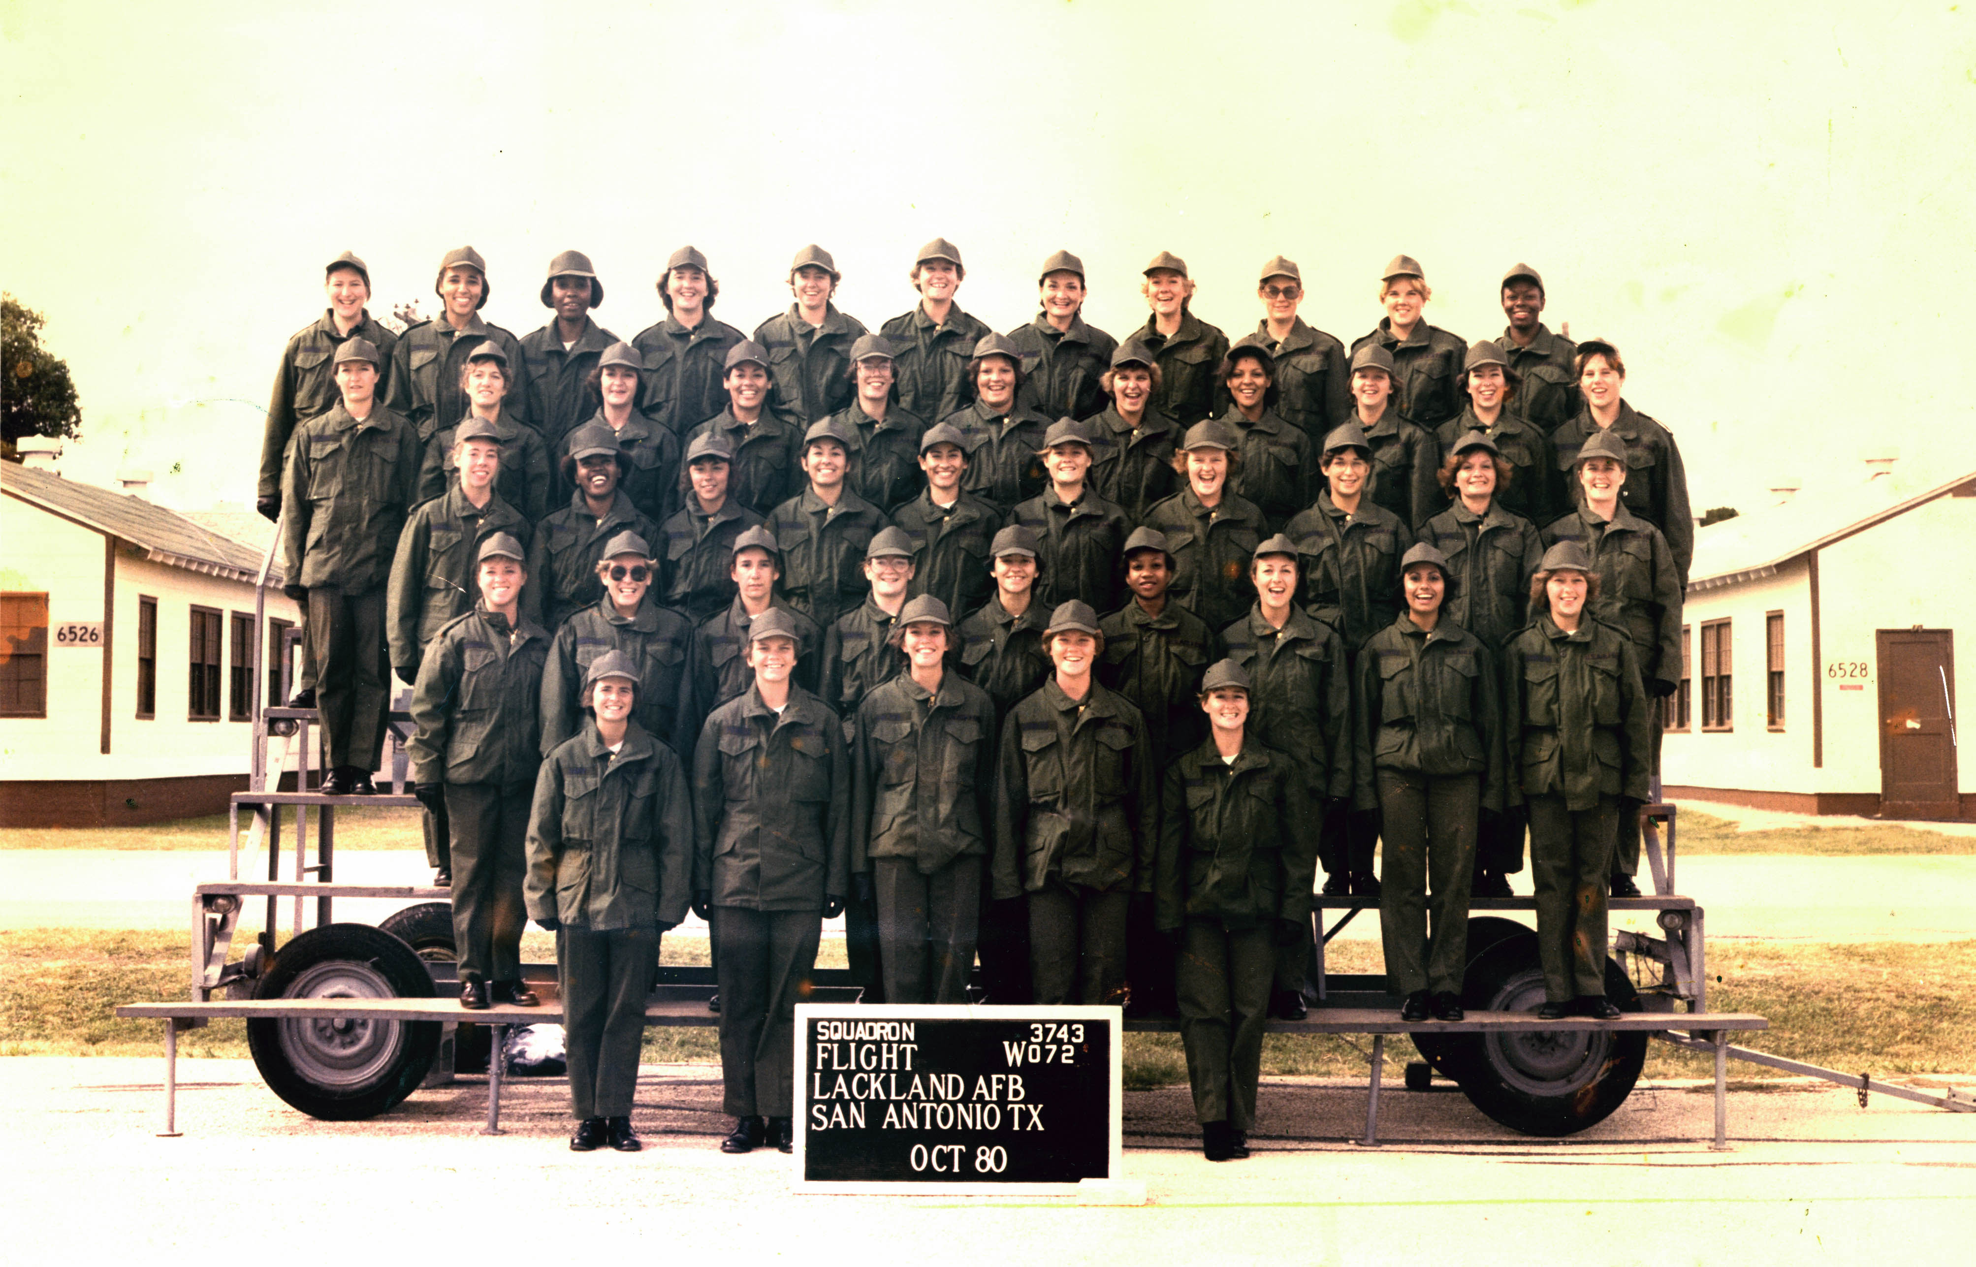

Slide 7


Slide 8
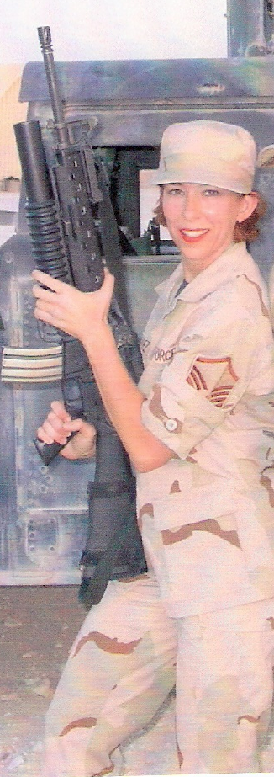


Slide 9
Negotiation
Notes:
Negotiation is basically discussions to agree on a deal, whether it’s a multimillion dollar deal or where to mee for dinner, its all negotiation.

Slide 10
Business Dictionary Definition
1. General: Bargaining (give and take) process between two or more parties (each with its own aims, needs, and viewpoints) seeking to discover a common ground and reach an agreement to settle a matter of mutual concern or resolve a conflict.
2. Banking: Accepting or trading a negotiable instrument
3. Contracting: Use of any method to award a contract other than sealed bidding.
4. Trading: Process by which a negotiable instrument is transferred from one party (transferor) to another (transferee) by endorsement or delivery. The transferee takes the instrument in good faith, for value, and without notice of any defect in the title of the transferor, and obtains an indefeasible title.

Slide 11
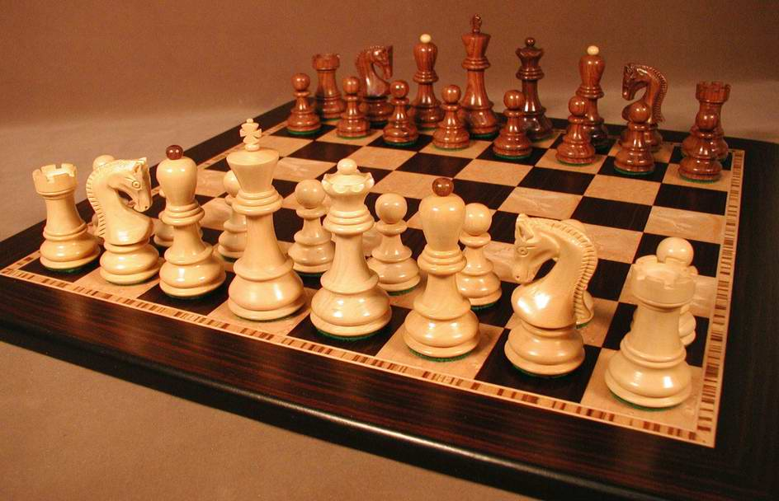
Notes:
Negotiation is similar to chess. Chess is a game of strategy and so is negotiation. If you think of negotiation as simply a game, it makes it much easier to accomplish. In chess each side has their strategy and one side goes first and makes a move, the other side considers the strategy then they make a move. It goes back and forth with each side moving based on the strategy used by the other side. Of course in chess there’s always a winner and a loser. As the negotiation I’m teaching it’s about win win negotiation where both sides win. Glen Morshower says “I don’t want to win at your expense, I want to win at your expanse” Many times negotiation is viewed as one side curshing the other side for an all out win. While that happens and sometimes is necessary, more often than not, negotiation can be a win win approach where both sides come out winning. Now we aren’t going to get everything we want, that’s why we go in with a bottom line of what we will accept. I am not going to go deep into some of the strategies today, I don’t have the time to do that, this is a basic overview. I go deeper into the strategies in my Think Like A Negotiator 3 day training. Plan to come along to that to go deeper into negotiation.

Slide 12
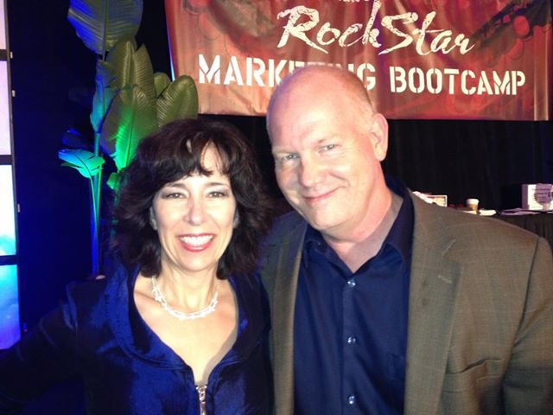
Win-Win
I don’t want to win at your expense, I want to win at your EXPANSE……
Glenn Morshower

Slide 13
Negotiation Situation
Plan/Prepare for Negotiation
Agreement
Negotiation
Definitize
Execute Agreement
Anatomy
of a Negotiation

Slide 14
Negotiation
Situation
Contracts
Landlord Tenant Dispute
Interest Rates
Client Agreements
Damaged Property
Contract Payment Terms
Joint Venture Agreements
Car/House Repairs
Employee Issues
Sponsorship
Salary
Delivery Delays

Slide 15
Fair and Reasonable
A Fair and Reasonable price can be defined as the price a prudent businessperson would pay for an item or service under competitive market conditions, given a reasonable knowledge of the marketplace. Fair implies a proper balance of conflicting interests. Reasonable means not extreme or excessive. So a fair and reasonable price is one that is balanced and somewhat moderate.

Slide 16





Slide 17
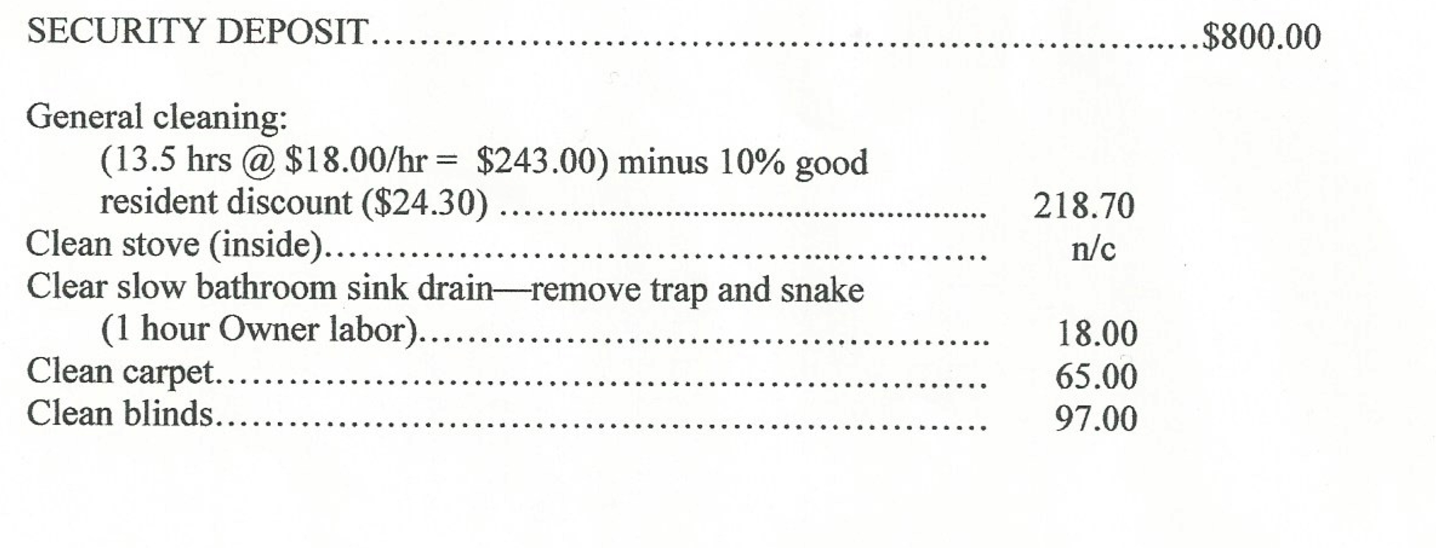
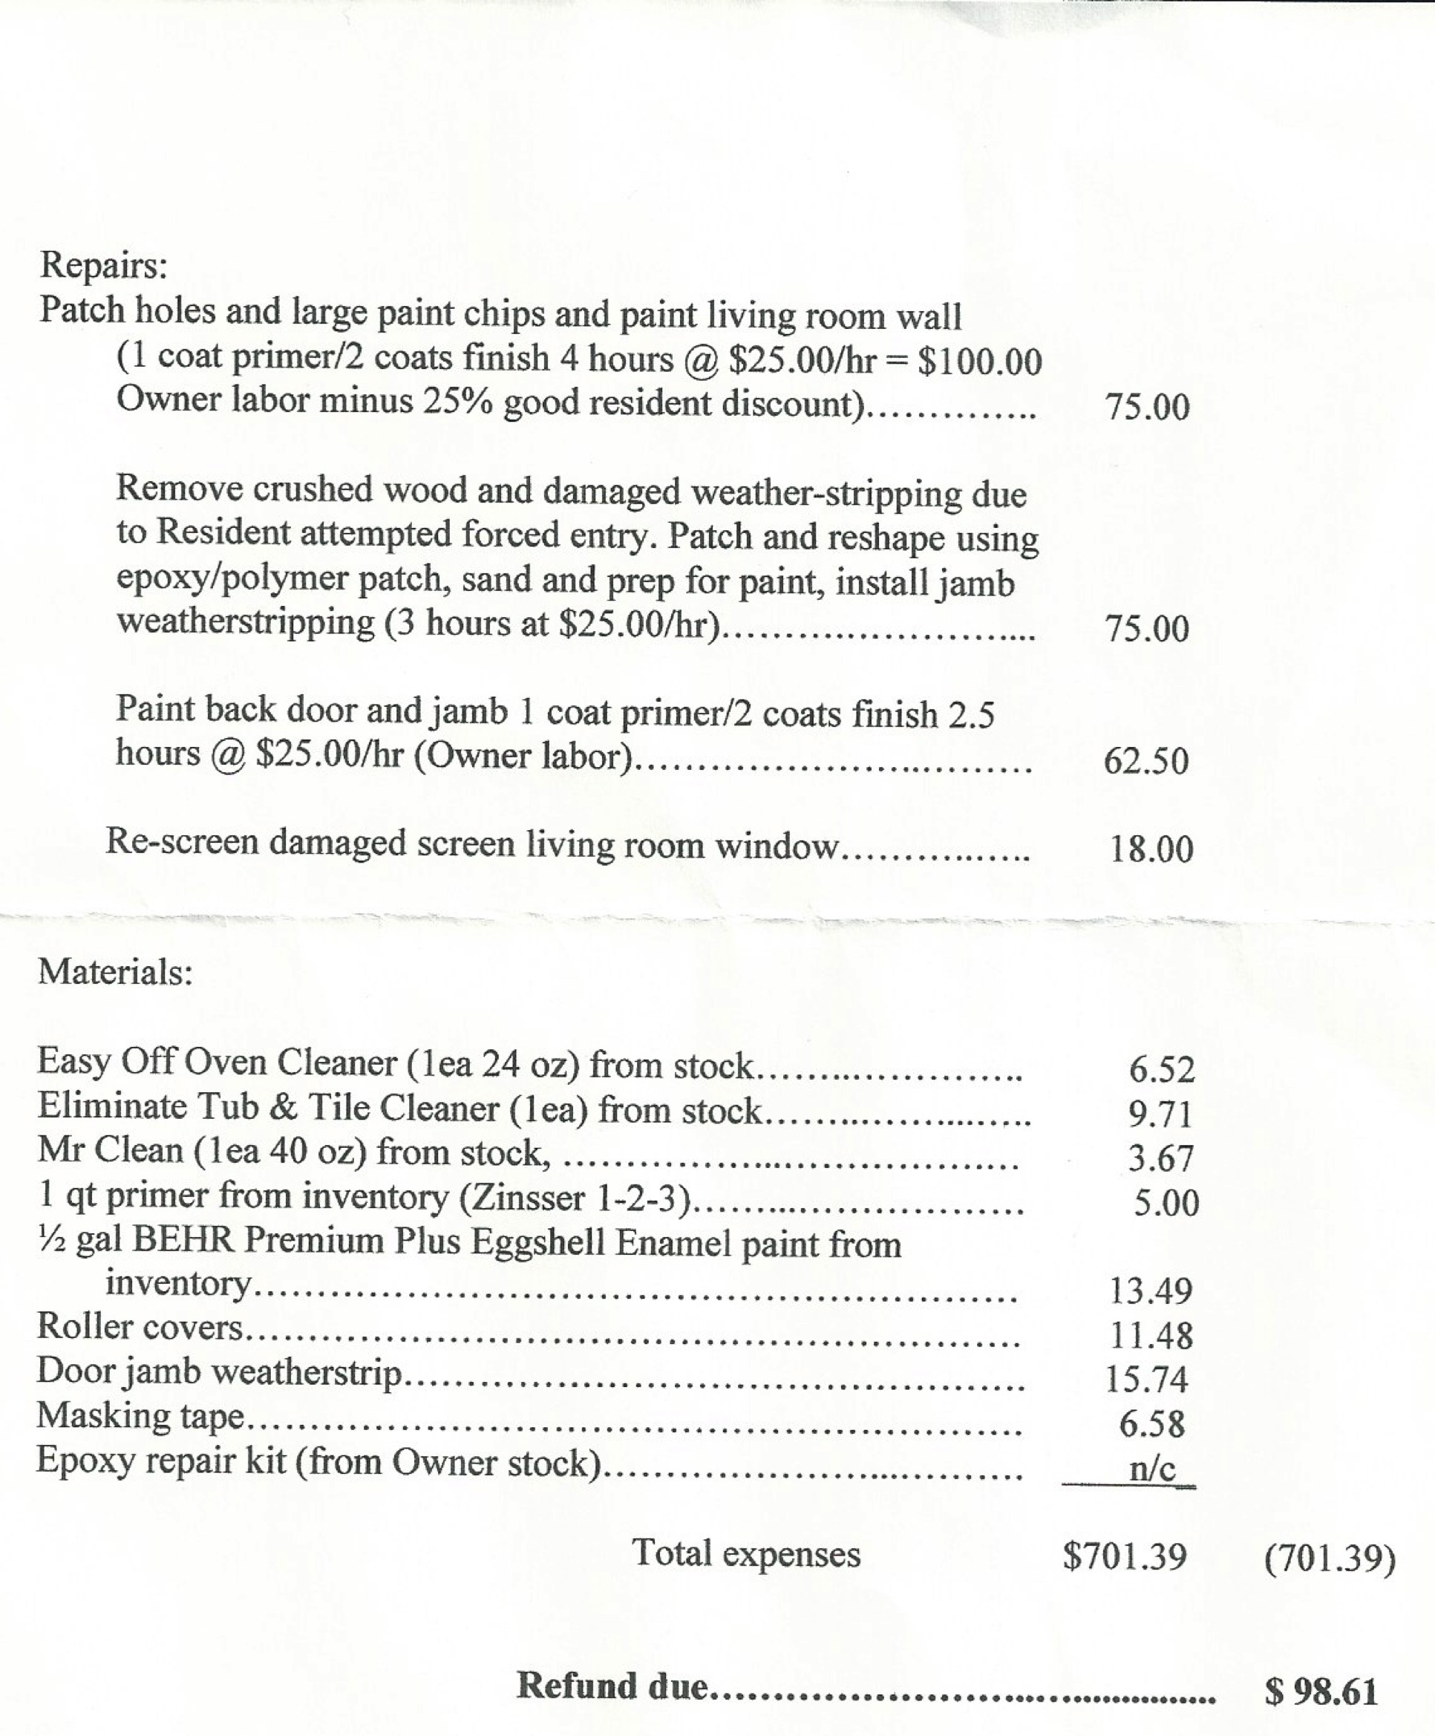
Landlords Breakdown of Charges

Slide 18


Slide 19
Negotiation Situation
Plan/Prepare for Negotiation
Agreement
Negotiation
Definitize
Execute Agreement
Anatomy
of a Negotiation

Slide 20
  7 Common
  Negotiation
  Mistakes

Slide 21
Mistake#1
Not having Confidence
Thinking it takes more Confidence than you already have to be a good negotiator
Notes:
2nd mistake What is the #1 thing you need to be a successful negotiator? CONFIDENCE?
If you lack confidence – the other side will sense that and use it as leverage against you. If it’s in person they will read it in your body language and facial expressions and even your tonality. If it’s on the phone they will hear it in your voice. Many times confidence comes from experience but it also comes from within, from your belief system about yourself and your self worth. What is the tape that plays in your head on a regular basis? Is it positive and uplifting or negative and destructive? What you think about you bring about so before you ever step up to negotiate anything, take a look at your level of confidence. What I told you about my childhood was only the tip of the iceberg. I had such low self esteem and no confidence in myself whatsoever. The tape that was playing in my head said I was no good, a loser, a high school dropout, who do I think I am, I’d never make anything of myself. I heard that in my mind every morning when I looked in the mirror. I hear this despite the fact that I had 3 degrees, I heard this through every promotion in the military, through every award I received. It didn’t matter that I was handling millions of dollars of contracts and leading groups of troops. It wasn’t until what I call my mirror experience where I realized I was not only the problem but also the solution that it started to turn around for me. HMOY would like to tell yourself how awesome you are and have it immediately change your life? It doesn’t matter if you don’t believe it. Mary Kay Ash always said fake it till you make it. You may not consciously believe it but your body, and spirit will before you consciously do in your mind. I want you to immediately change your life in this area. It’s my free gift to you (biz card or email form depending on event) or free at back of room.

Slide 22
Own Your Power
Confidence
Creates
Captivation
Notes:
2nd mistake What is the #1 thing you need to be a successful negotiator? CONFIDENCE?
If you lack confidence – the other side will sense that and use it as leverage against you. If it’s in person they will read it in your body language and facial expressions and even your tonality. If it’s on the phone they will hear it in your voice. Many times confidence comes from experience but it also comes from within, from your belief system about yourself and your self worth. What is the tape that plays in your head on a regular basis? Is it positive and uplifting or negative and destructive? What you think about you bring about so before you ever step up to negotiate anything, take a look at your level of confidence. What I told you about my childhood was only the tip of the iceberg. I had such low self esteem and no confidence in myself whatsoever. The tape that was playing in my head said I was no good, a loser, a high school dropout, who do I think I am, I’d never make anything of myself. I heard that in my mind every morning when I looked in the mirror. I hear this despite the fact that I had 3 degrees, I heard this through every promotion in the military, through every award I received. It didn’t matter that I was handling millions of dollars of contracts and leading groups of troops. It wasn’t until what I call my mirror experience where I realized I was not only the problem but also the solution that it started to turn around for me. HMOY would like to tell yourself how awesome you are and have it immediately change your life? It doesn’t matter if you don’t believe it. Mary Kay Ash always said fake it till you make it. You may not consciously believe it but your body, and spirit will before you consciously do in your mind. I want you to immediately change your life in this area. It’s my free gift to you (biz card or email form depending on event) or free at back of room.

Slide 23



Slide 24


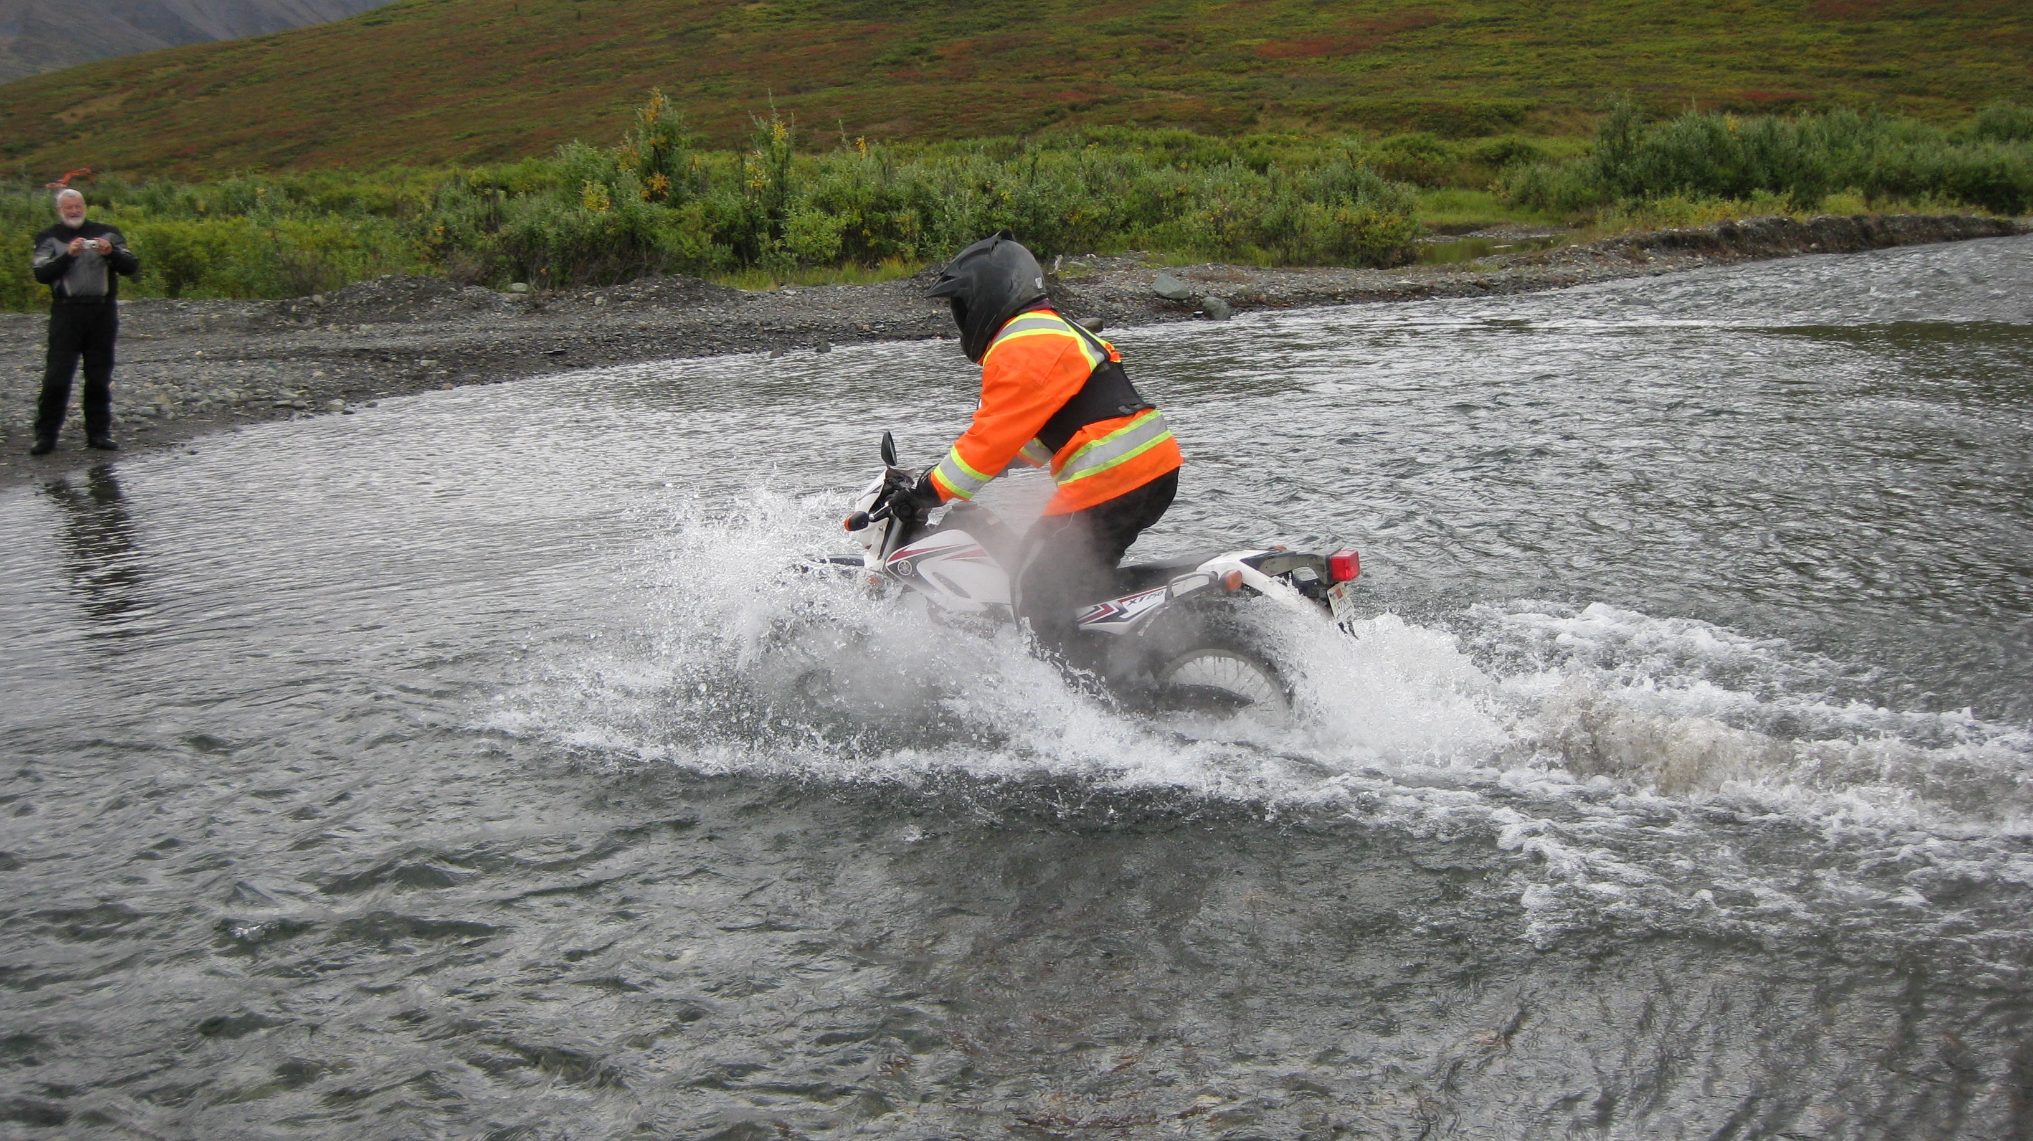

Slide 25
Pay to Play

Slide 26
Mistake#2
Thinking
Everything
Is Not
Negotiable

Slide 27
Everything
Is
Negotiable
Notes:
Everything is Negotiable when you Think Like A Negotiator. Often times what we see as rules or statutes are really just guidelines. Put on the mindset.

Slide 28
Mistake #3
Not
Being Prepared

Slide 29
Prepare
In
Advance
Notes:
Let me tell you about one of the games in my TLN Live Training. This game is all about understanding Non Disclosure Agreements, Preparing Proposals and Contracts. These are not only things you need to know in business but also in day to day life because we are often asked to sign agreements and contracts.
There is something in one of the documents that says if you fail to put a red X in a certain spot on the document that 95% of the profits from the deal will go to the company you are dealing with. It never fails. Every single time at least one and usually more than one team fails to read the entire document and doesn’t put the red X! Read It! So when you come to the Think Like A Negotiator Live training you will remember to read it and find where you are suppose to put the red X so you don’t lose all your profits!

Slide 30
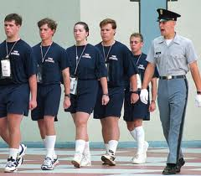

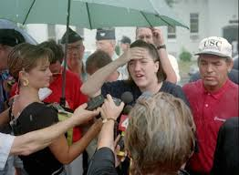
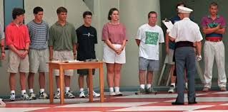

Slide 31
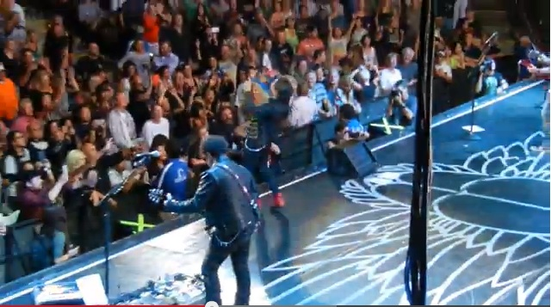






Slide 32
Mistake #4
Not
Looking
The
Part

Slide 33
Look
The
Part
Notes:
Let me tell you about one of the games in my TLN Live Training. This game is all about understanding Non Disclosure Agreements, Preparing Proposals and Contracts. These are not only things you need to know in business but also in day to day life because we are often asked to sign agreements and contracts.
There is something in one of the documents that says if you fail to put a red X in a certain spot on the document that 95% of the profits from the deal will go to the company you are dealing with. It never fails. Every single time at least one and usually more than one team fails to read the entire document and doesn’t put the red X! Read It! So when you come to the Think Like A Negotiator Live training you will remember to read it and find where you are suppose to put the red X so you don’t lose all your profits!

Slide 34
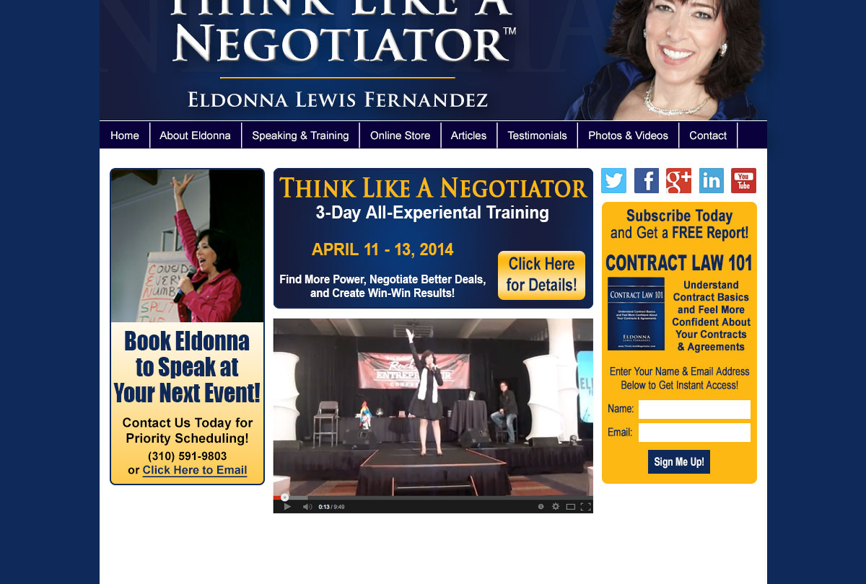





Slide 35
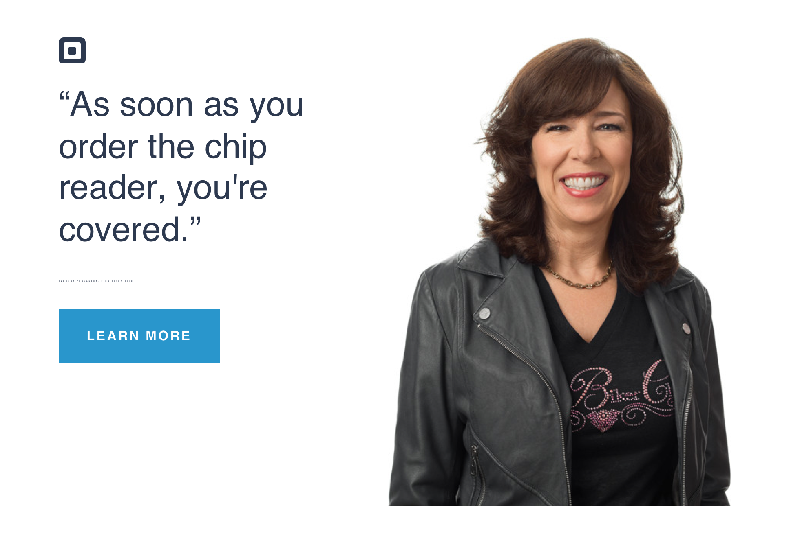
Got Square?

Slide 36

Photo by Peter Yang – Featured in AARP Magazine Oct/Nov 2015

Slide 37
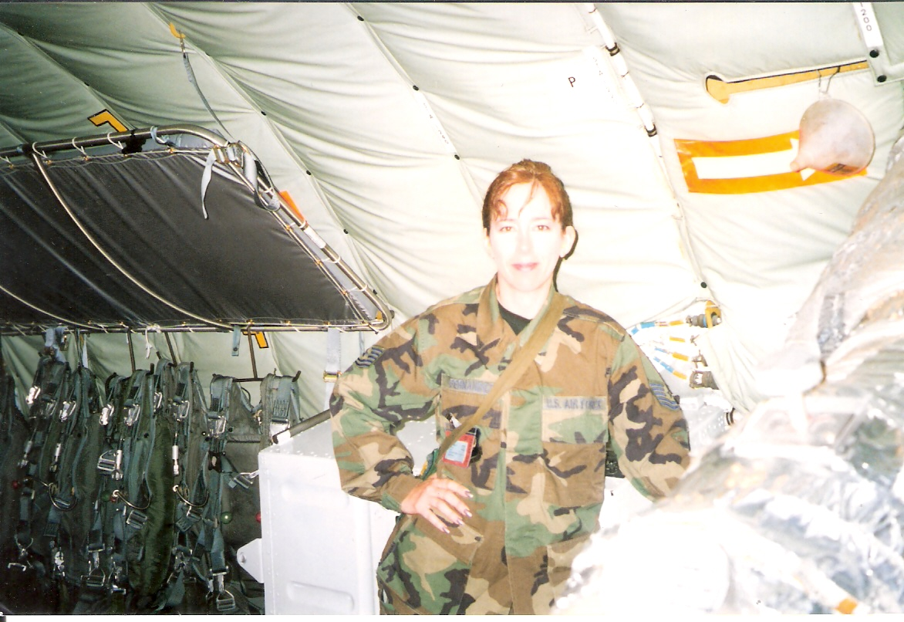
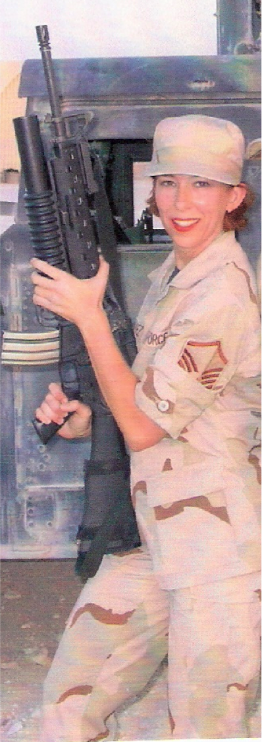
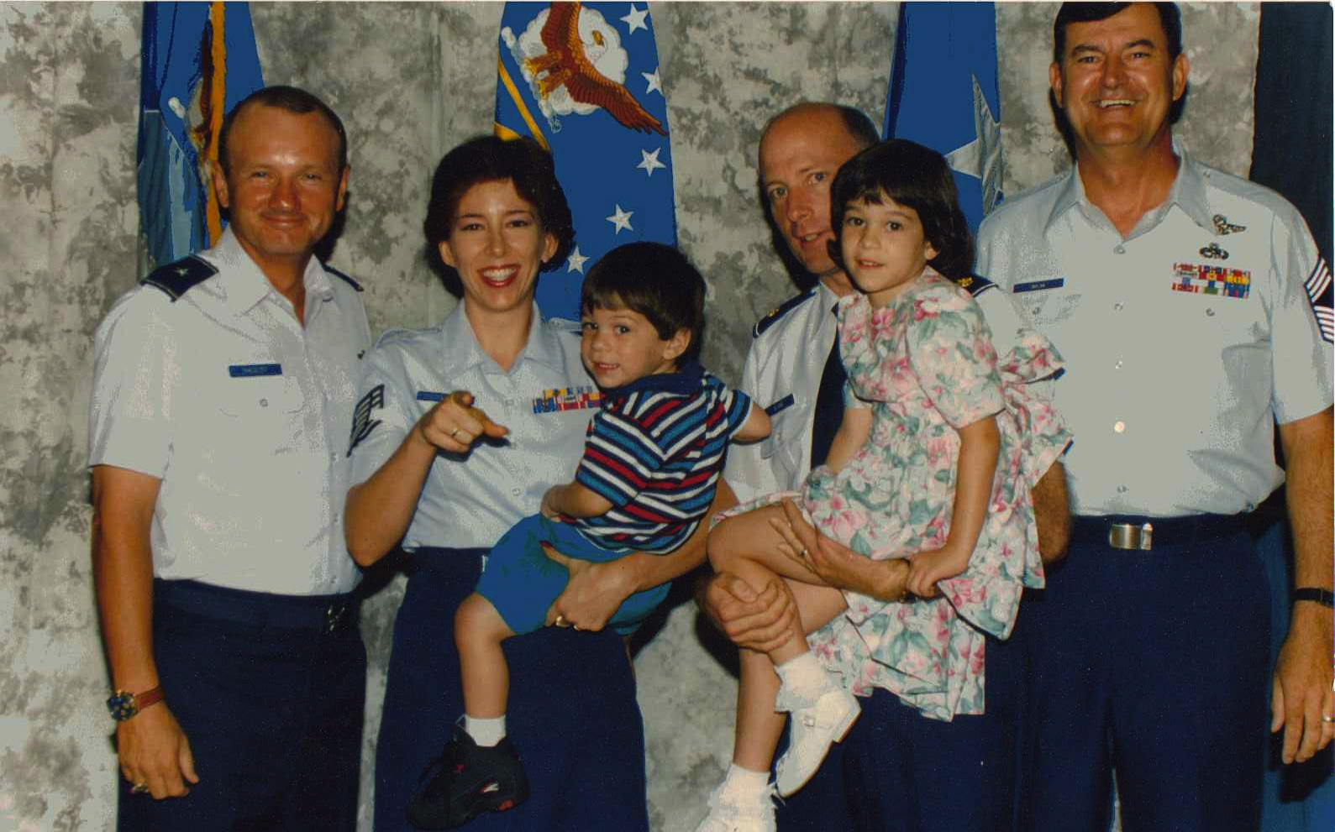

Slide 38
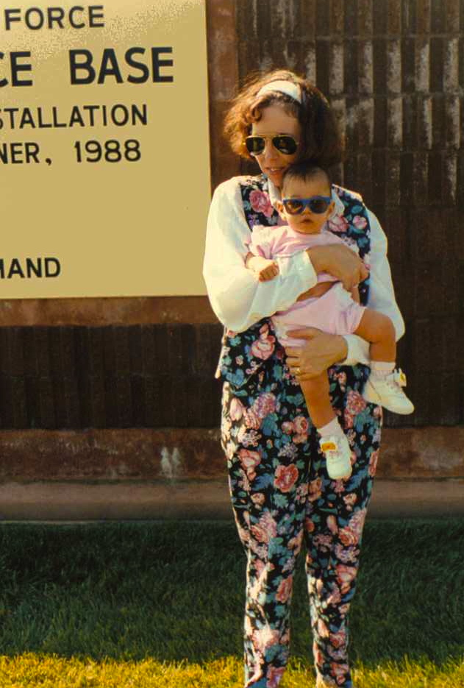
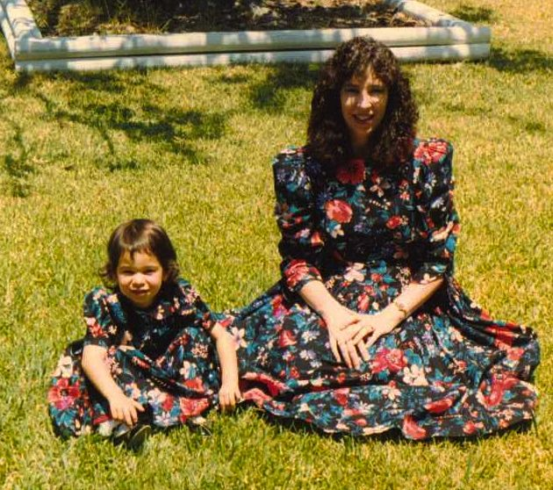

Slide 39
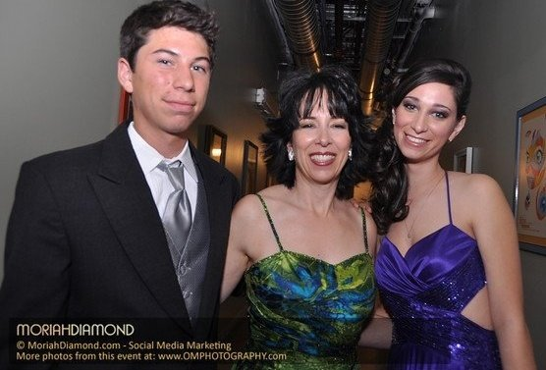
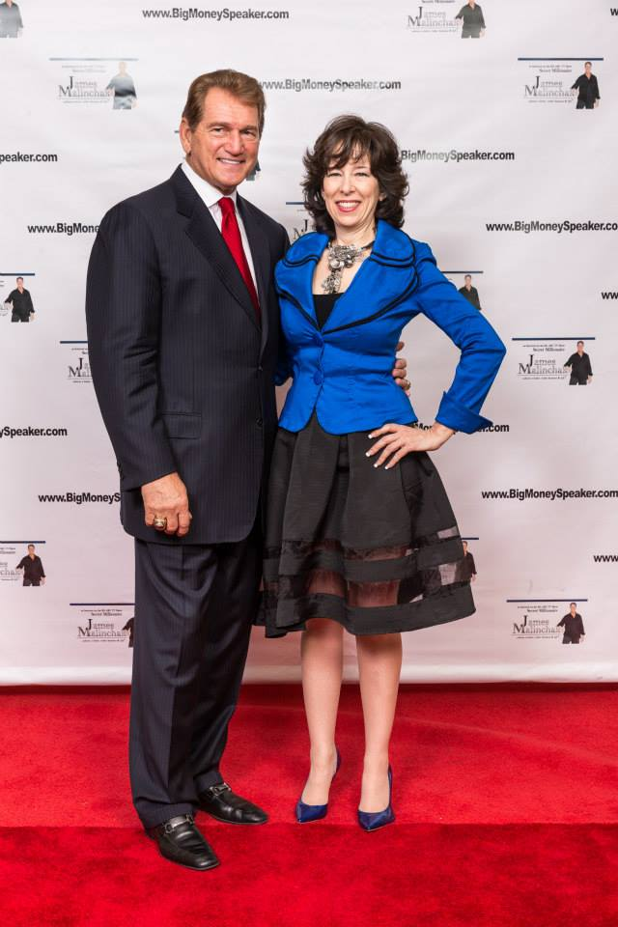
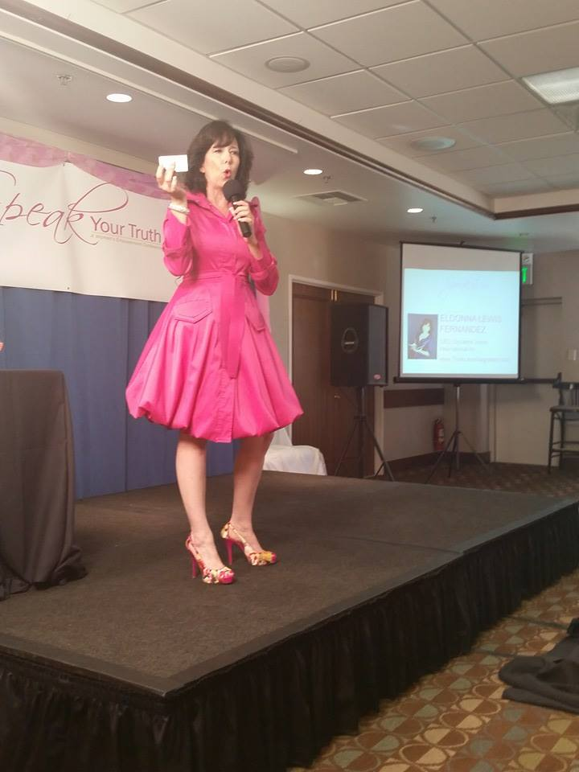


Slide 40
Mistake #5
Not
Building
Relationships
First

Slide 41

Build
Relationships
First
Notes:
It really is not what you know, it’s who you know
If you are looking to get more contracts with the Government or get your first Gov’t Contract, team with a prime to get introduced to the system.
Relationship economy
Know Like and Trust Factor

Slide 42
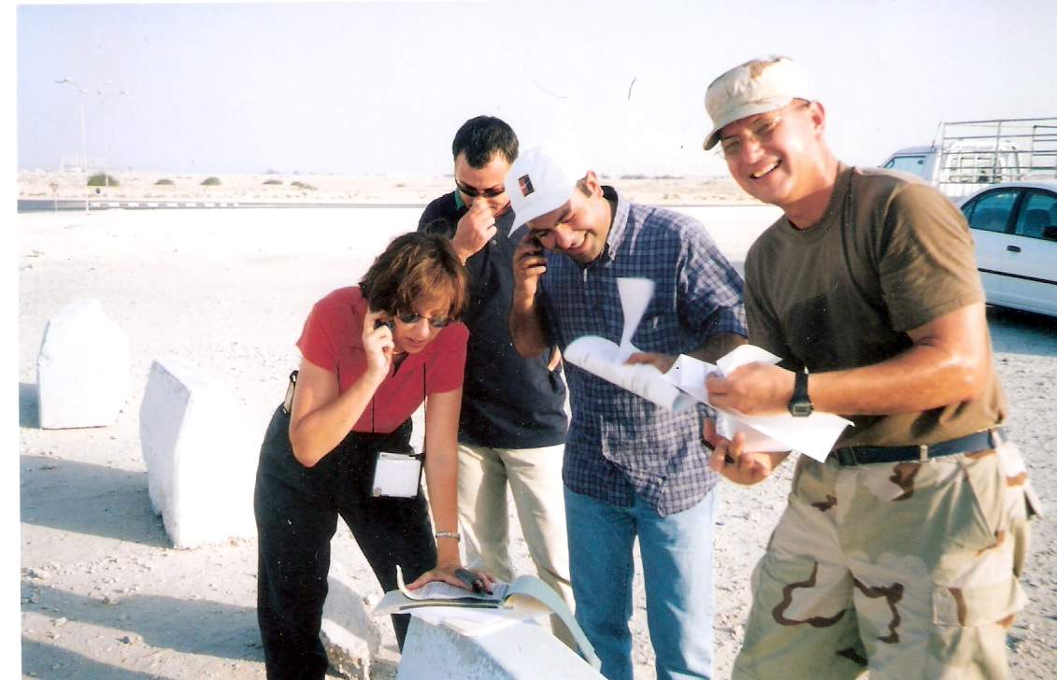
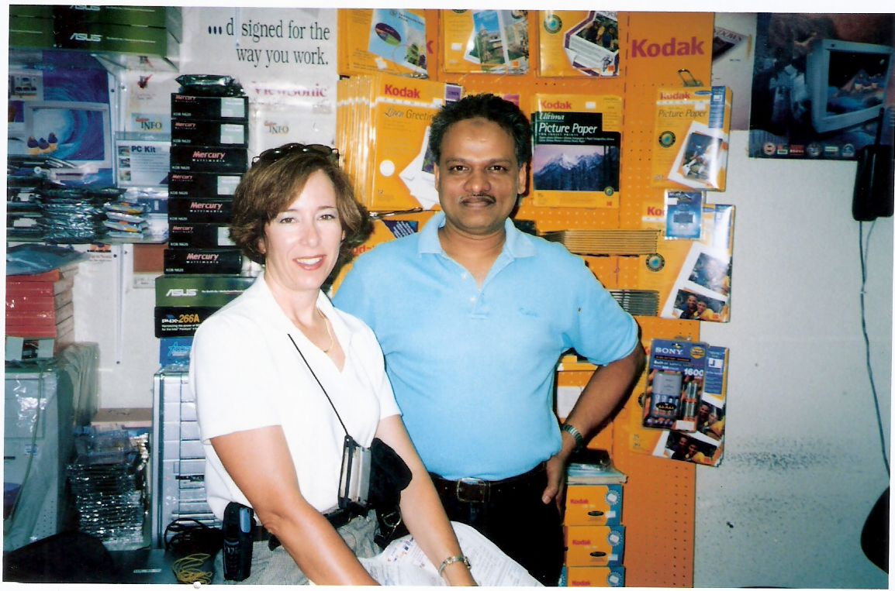



Slide 43
EXERCISE

Slide 44
Bonus
Not
Using
The Right
Strategy

Slide 45
Common Negotiation Strategies
Split the Difference
Never Take the First Offer
Up Your Price
Start Low
Deflection By Rant
Be Willing to Walk Away

Slide 46
Mistake #6
Not
Asking
The Right
Questions

Slide 47
Ask
For Exactly
What I Want

Slide 48
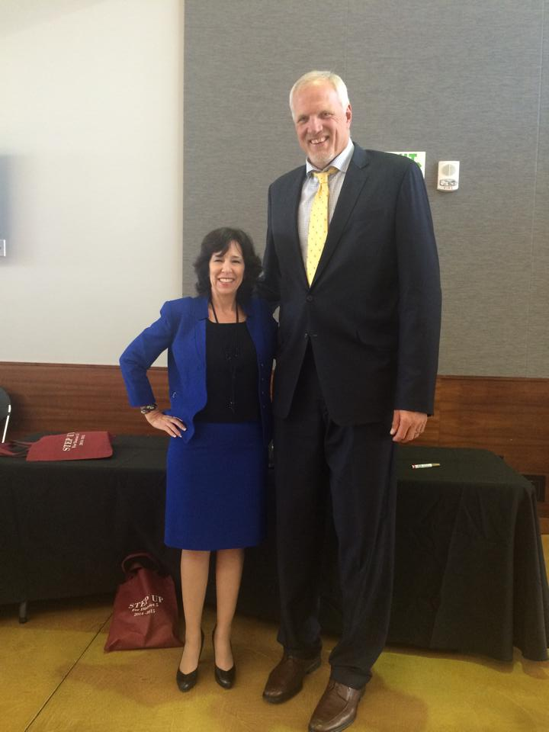

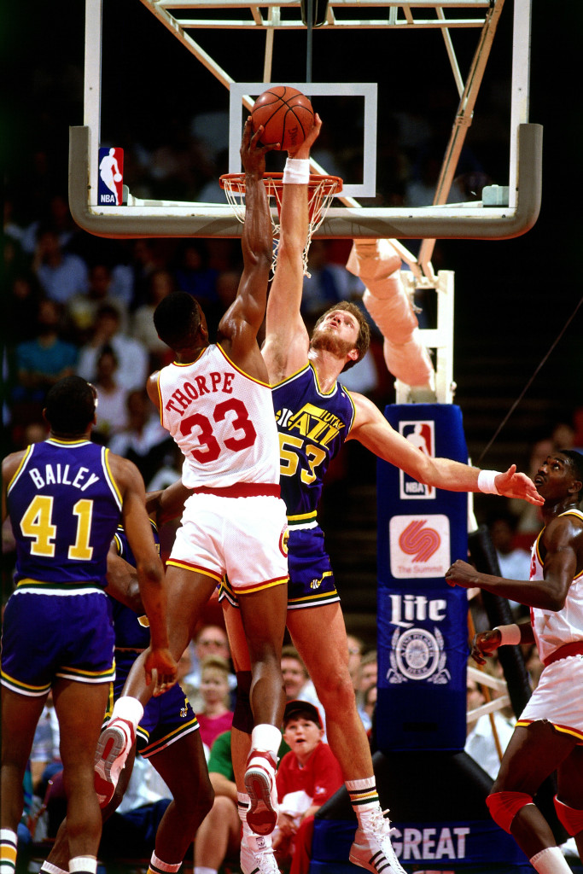
Played 12 Years for the Utah Jazz
Holds record for most blocks in a season -456
NBA All Star Once
NBA Defensive Player of the Year Twice

Slide 49
Ask
Powerful
Questions

Slide 50
Ask Powerful Questions
Would you explain the reasons for your position?
Why is that important to you or your company?
What is your why?
What do we need to do to reach an agreement?
What can I do to help you make a decision?
What are your priorities?
What information do you have that supports that offer?
How did you arrive at those number/that price?
What would you do if you were me?
What part of the offer gives you the most concern?
Is there anything else that you think I should know?

Slide 51
Ask
For
Consideration

Slide 52
Mistake #7
Talking
Too Much

Slide 53

Stop
Talking
Notes:
Story about my sister

Slide 55
Think Like A Negotiator
TLN Live Training
April 2016
Fairfield Inn Tustin CA (Orange County)
www.ThinkLikeANegotiator.com

Slide 56


