Slide 2
Leveraging technology to provide entrepreneurship education, financial literacy and access to capital.

Slide 4
Socioeconomic Systematic Challenges
Inclusion
Low income entrepreneurs
are trapped in the cycle of poverty and
are left out of the economic development system
Access
Globally, low-income people have
limited or no access to entrepreneurship education,
mentorship, and capital
Cost/Scaling
Entrepreneurship training costs ($4.5k/entrepreneur) limit providers to serve only 3% to 4% of the total market demand (28+ million small businesses in the US)
Linkages
Loan providers are looking for ways to connect to
loan-ready borrowers and technical assistance providers
are often disconnected from one-another

Slide 5
Creating tools for
entrepreneurs
Mobile App
Workbook
Train-the-trainer
Nonprofits
Providing workforce
development services
Workshops
Bootcamps
1-on-1 Mentoring
Entrepreneurs
Low-income, minorities,
women
Fundable business plans
Capital access
Job creation

Slide 6
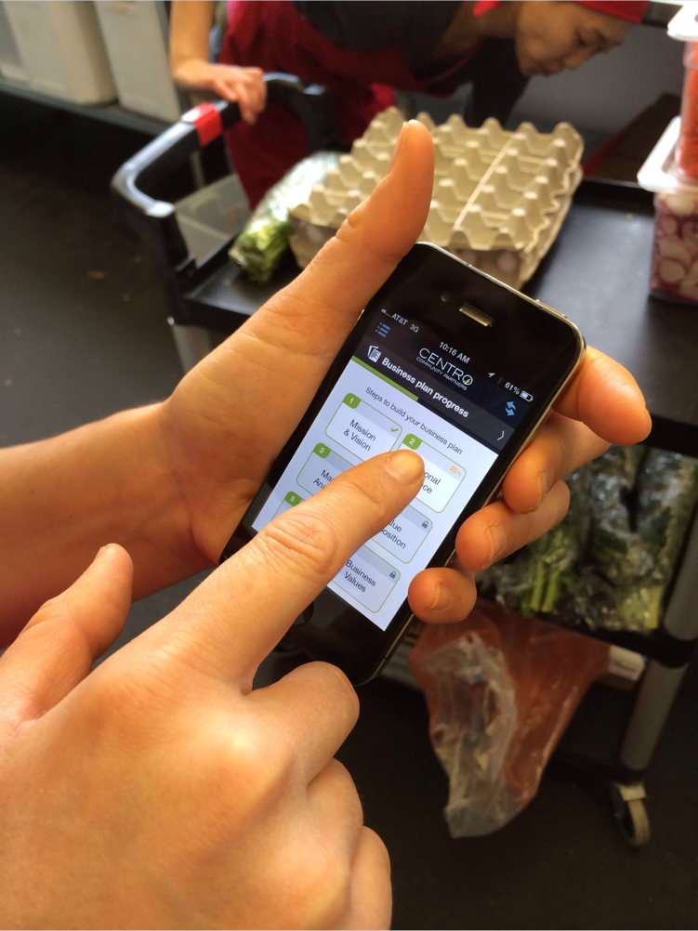
Centro Business Planning App

Slide 7
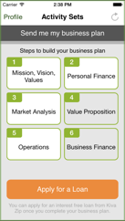
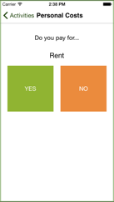
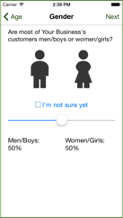
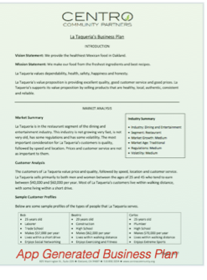
Create a Business Plan & Access Capital
Micro-Loan
Go through 25 activities to complete
Business
Plan

Slide 8
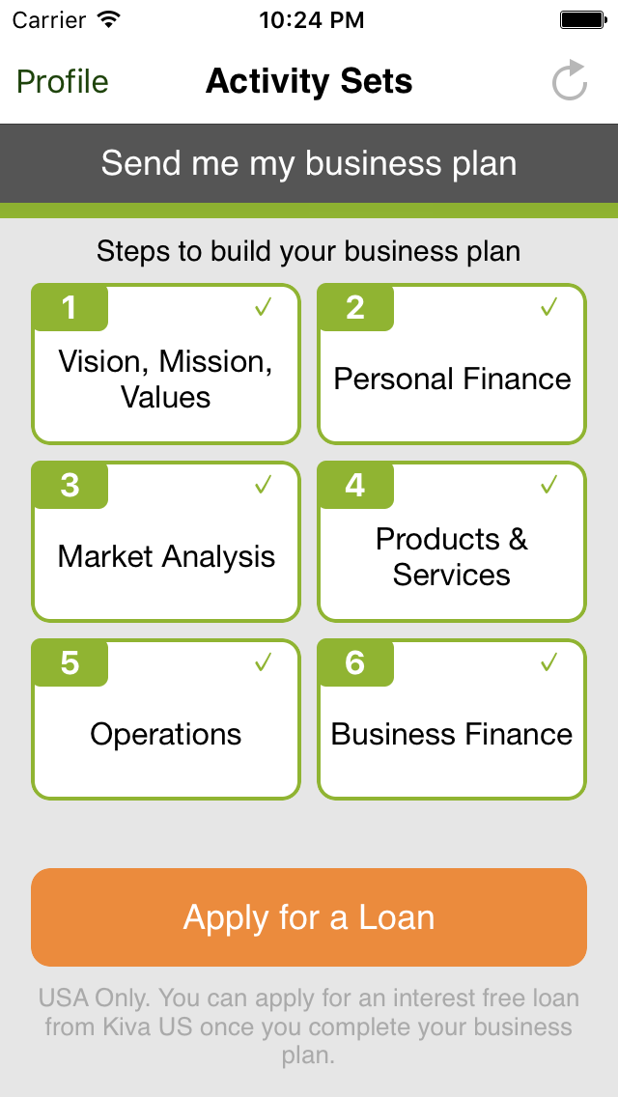

Slide 10
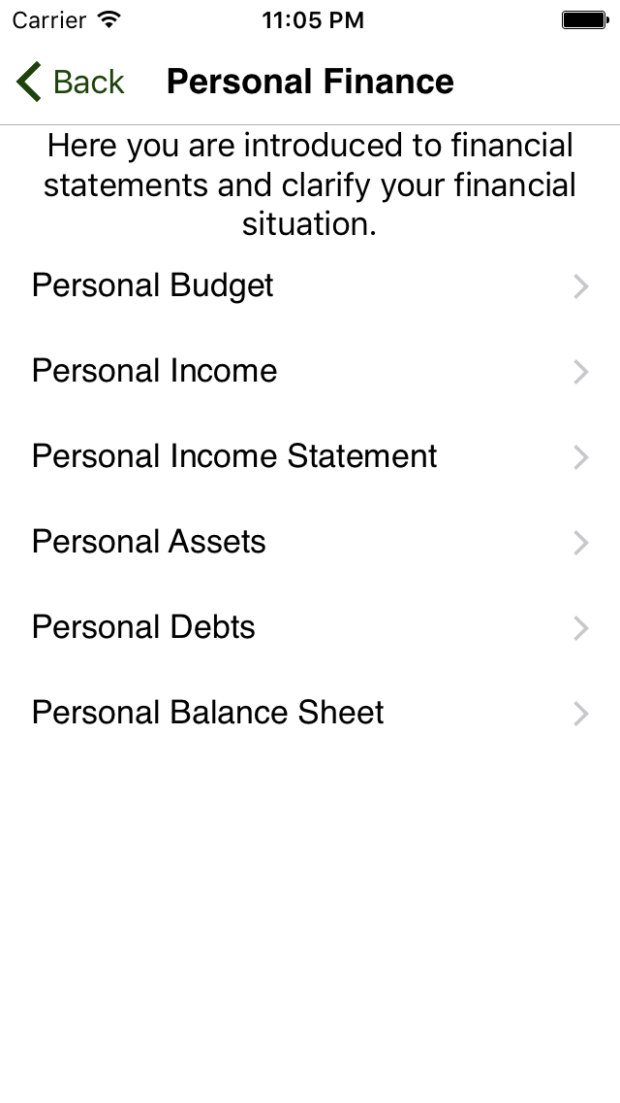

Slide 12
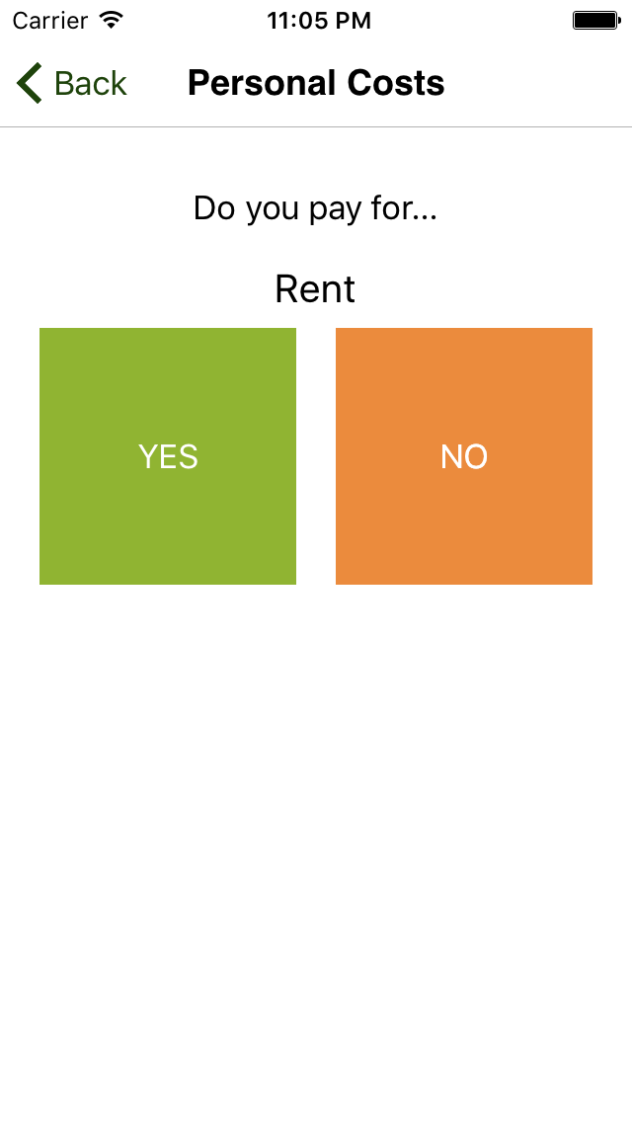

Slide 14
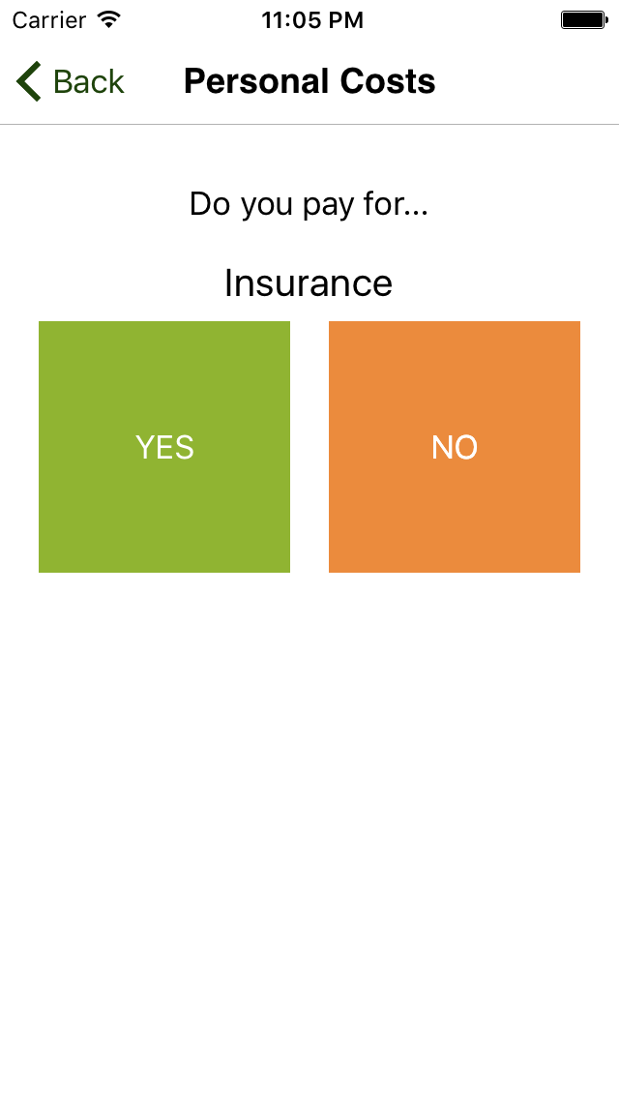

Slide 16
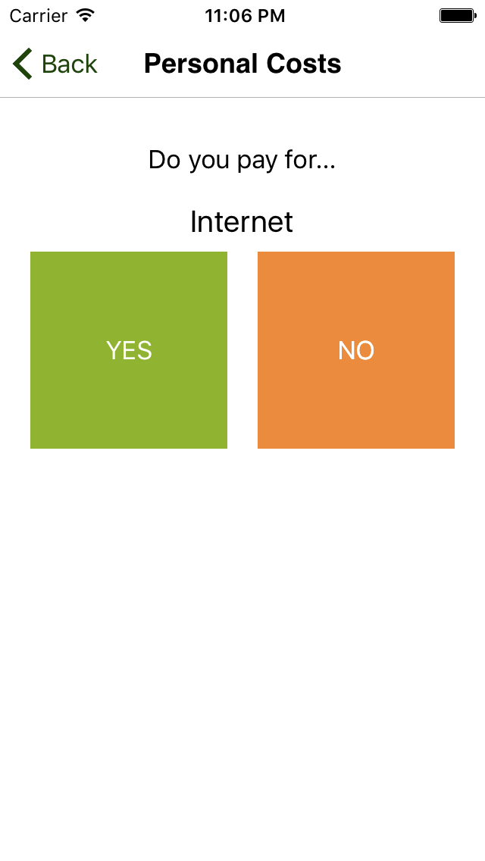

Slide 18
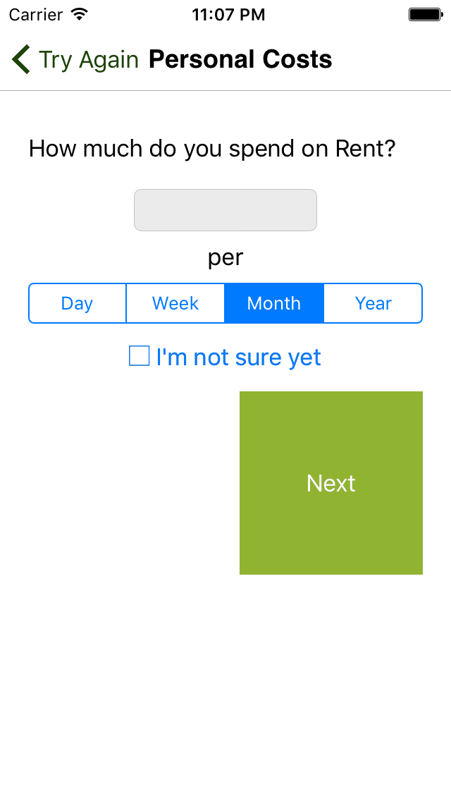

Slide 19
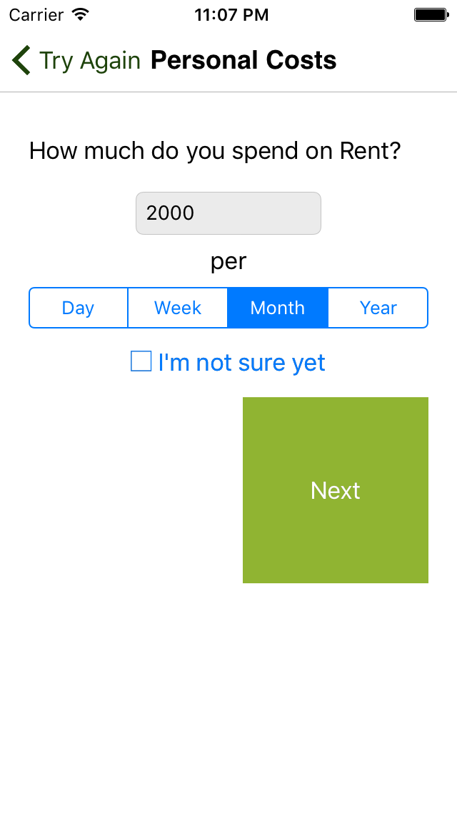

Slide 20
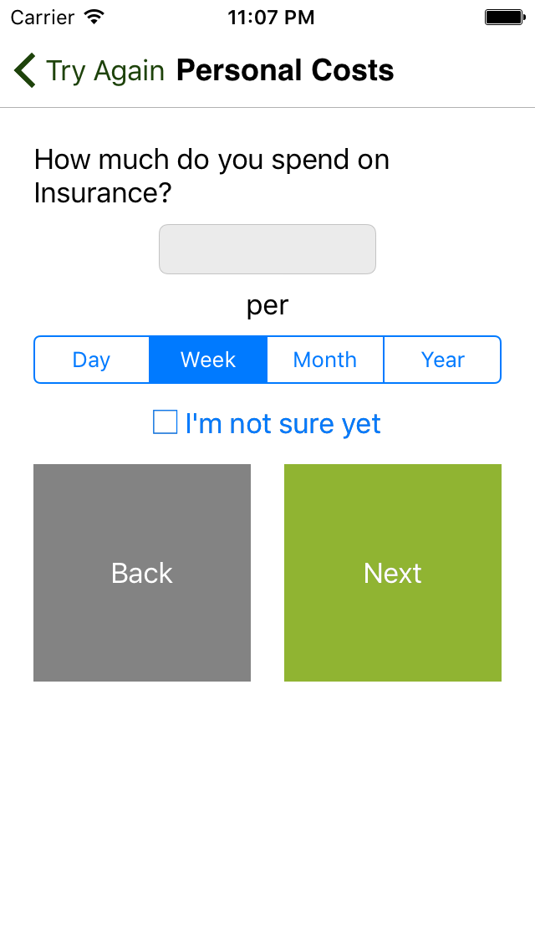

Slide 21
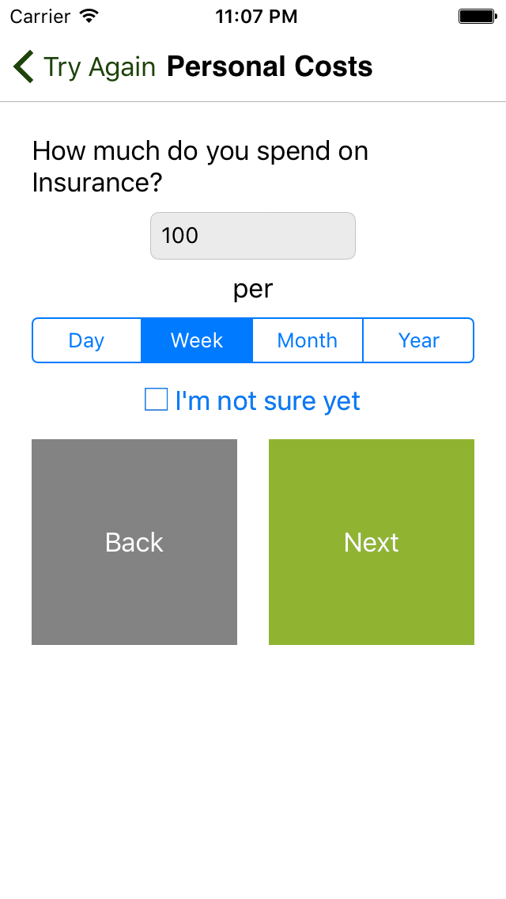

Slide 22
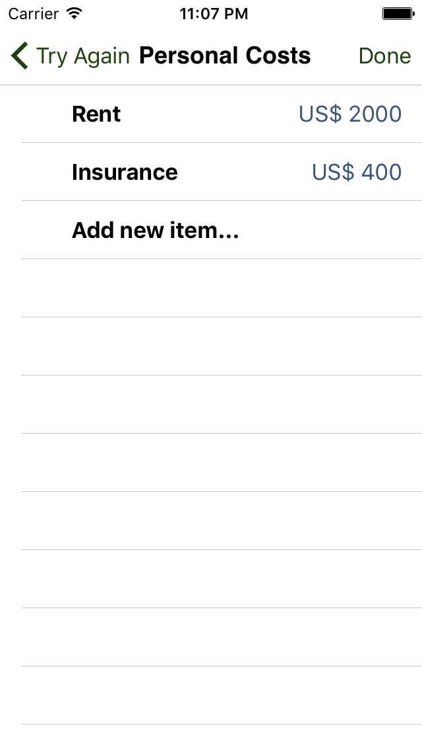

Slide 25
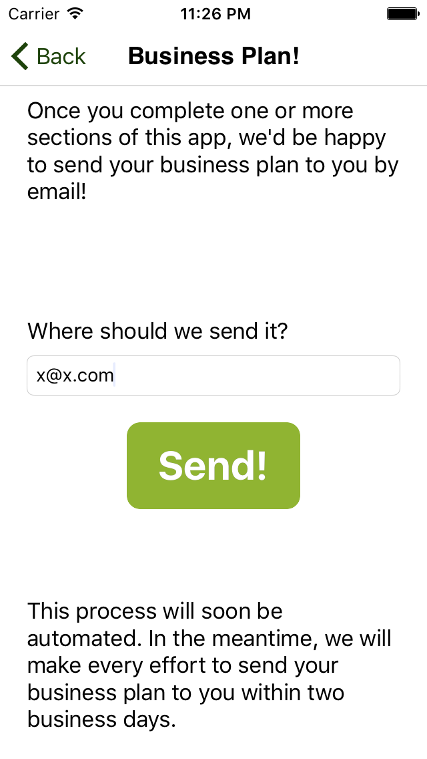
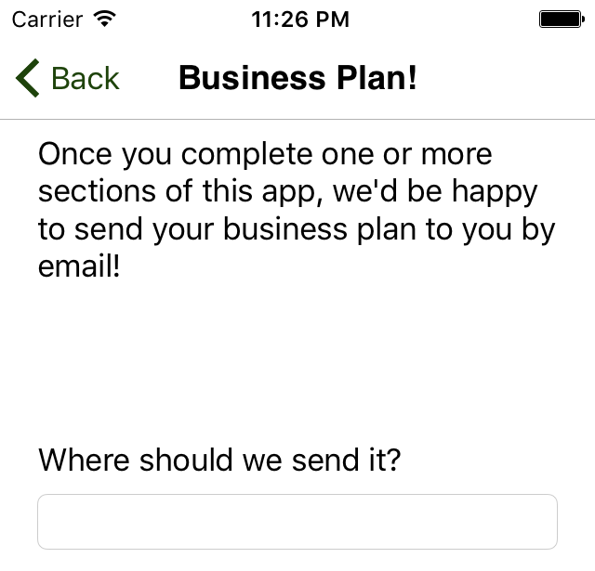

Slide 26
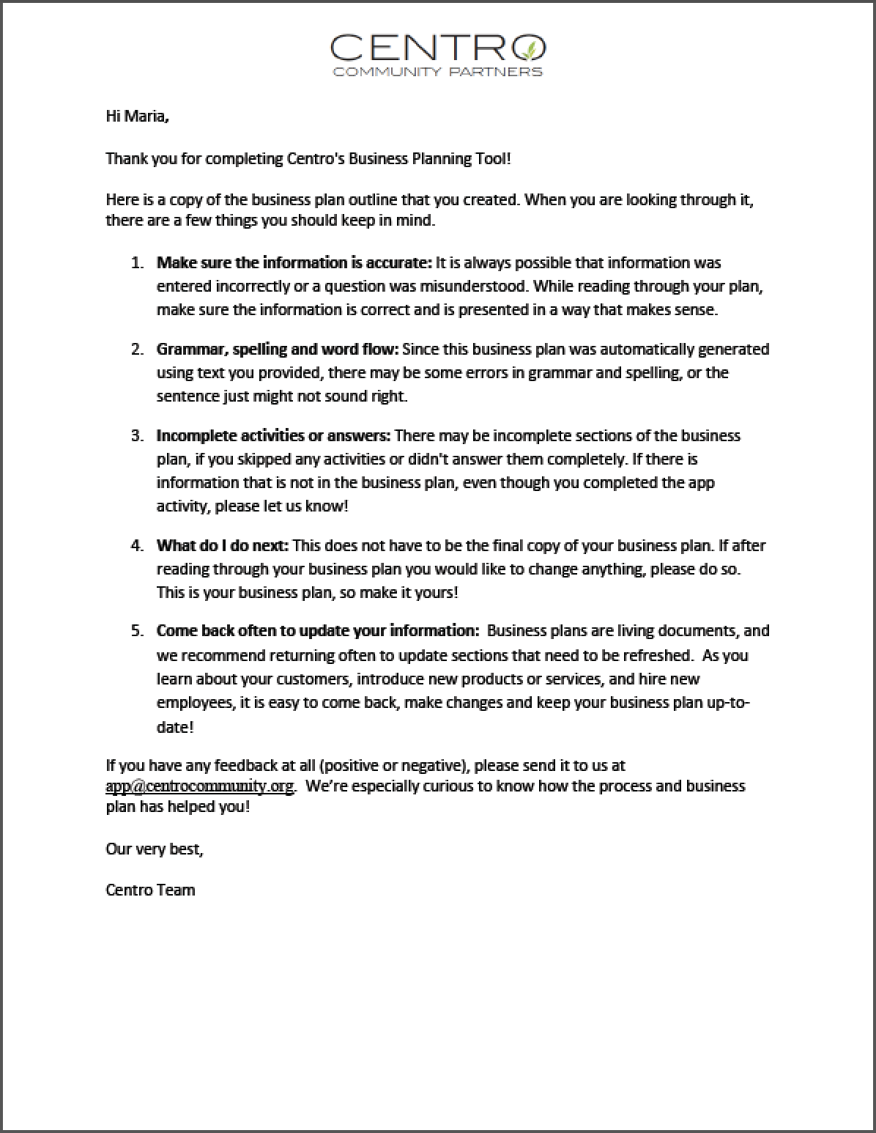
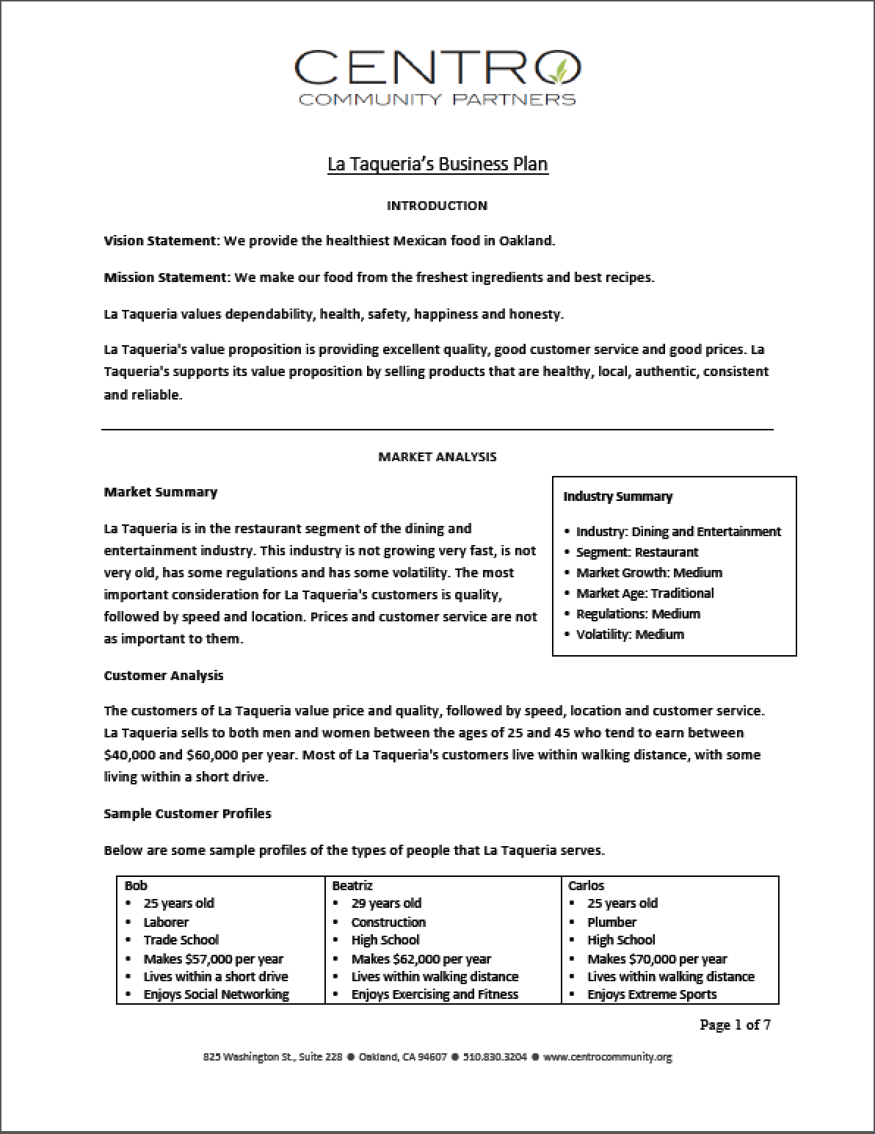
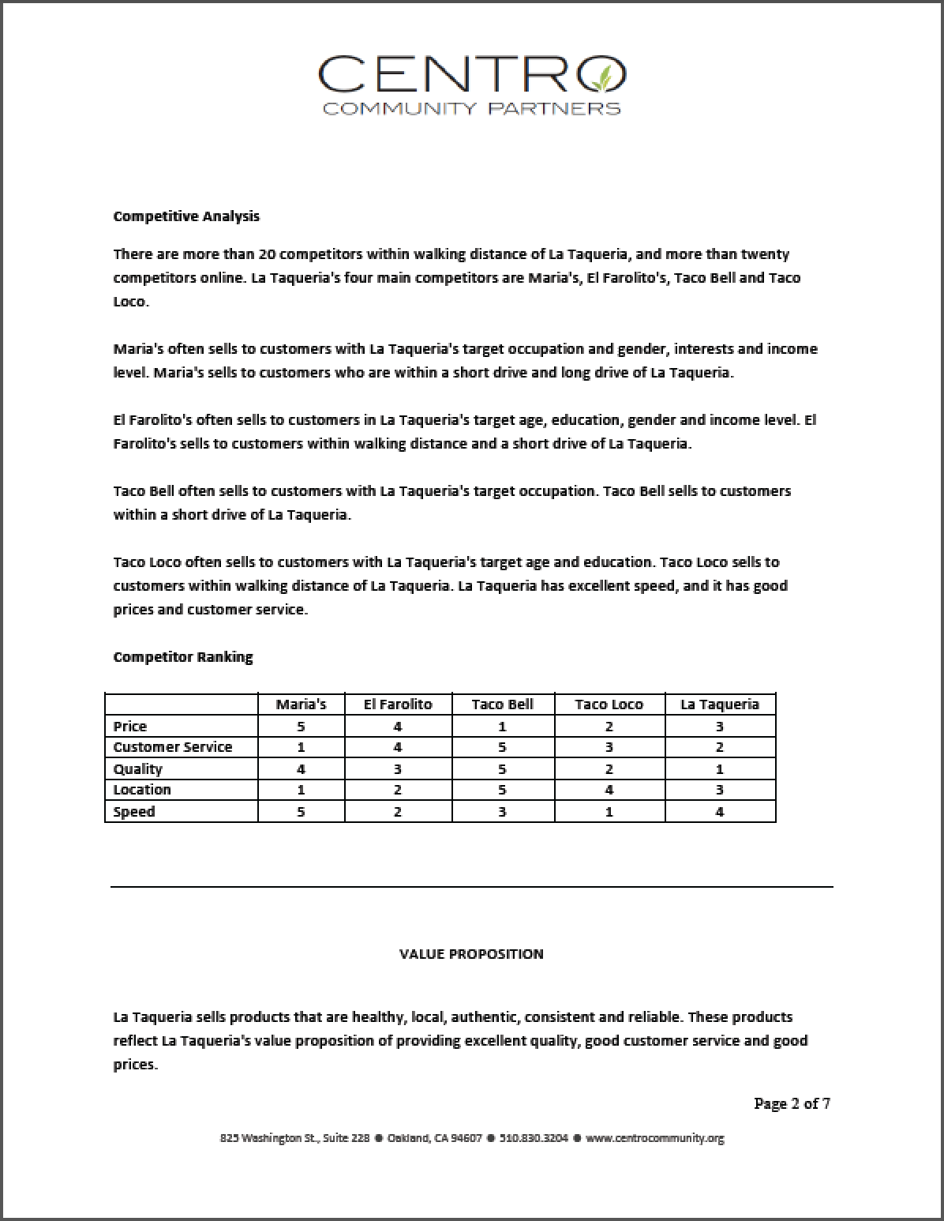

Slide 27
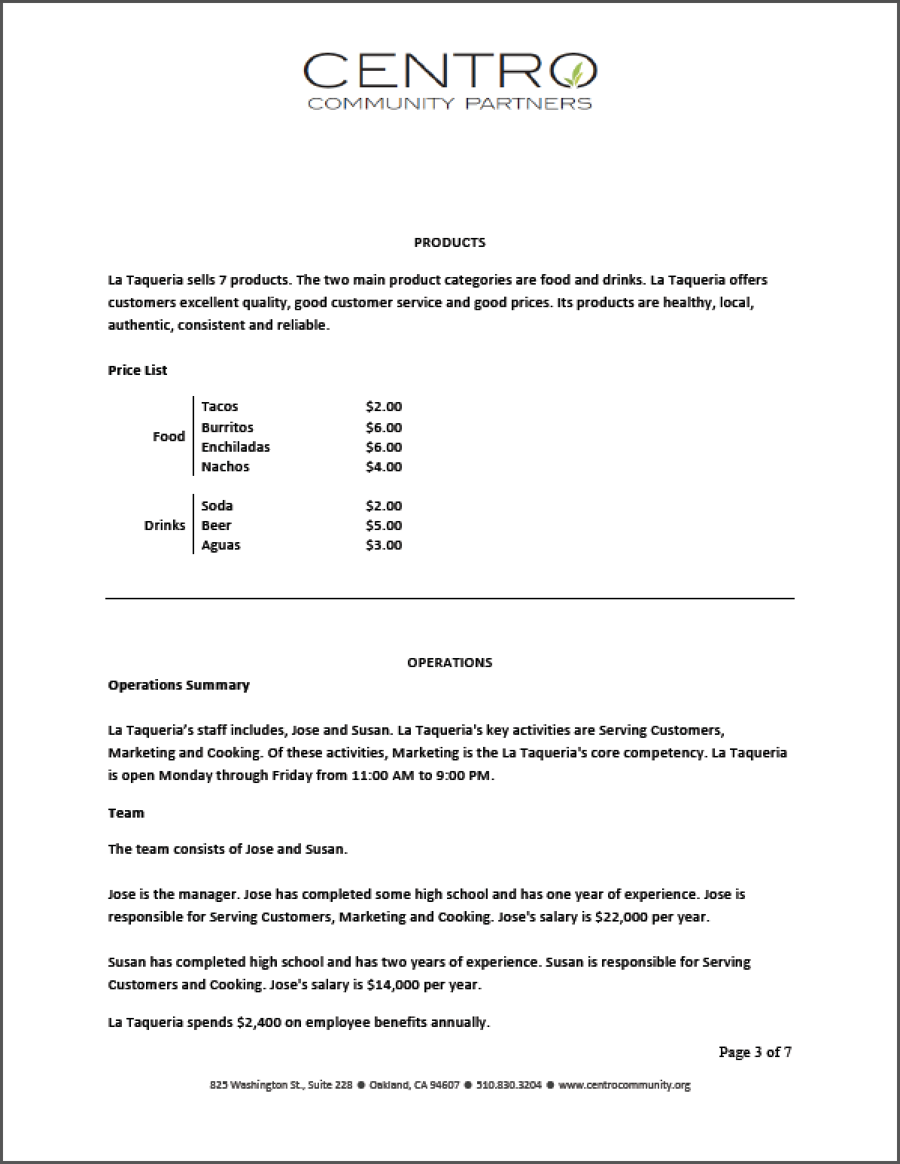

Slide 30
15,500+ downloads in 144 countries
13% in Europe
54% in US and Canada
8% in Asia Pacific
13% in
Latin America & Caribbean
12% in Africa, The Middle East and India
1,700+ completed business plans

Slide 31
82% Increased Business Revenue
84% Reduced Expenses
76% Increased Savings
42% Created Jobs 16% Applied for a loan

Slide 32
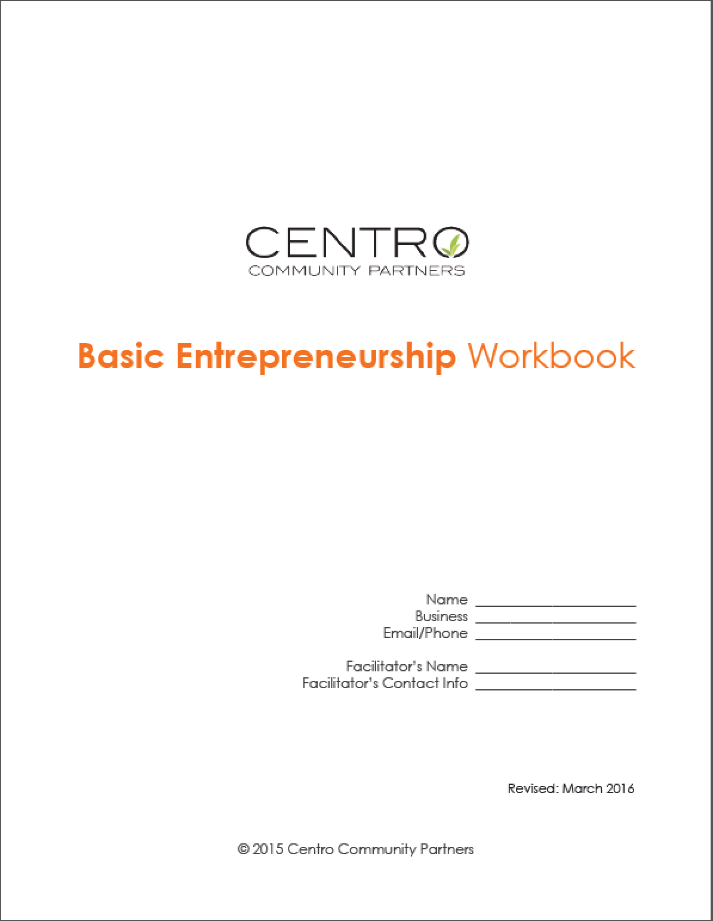
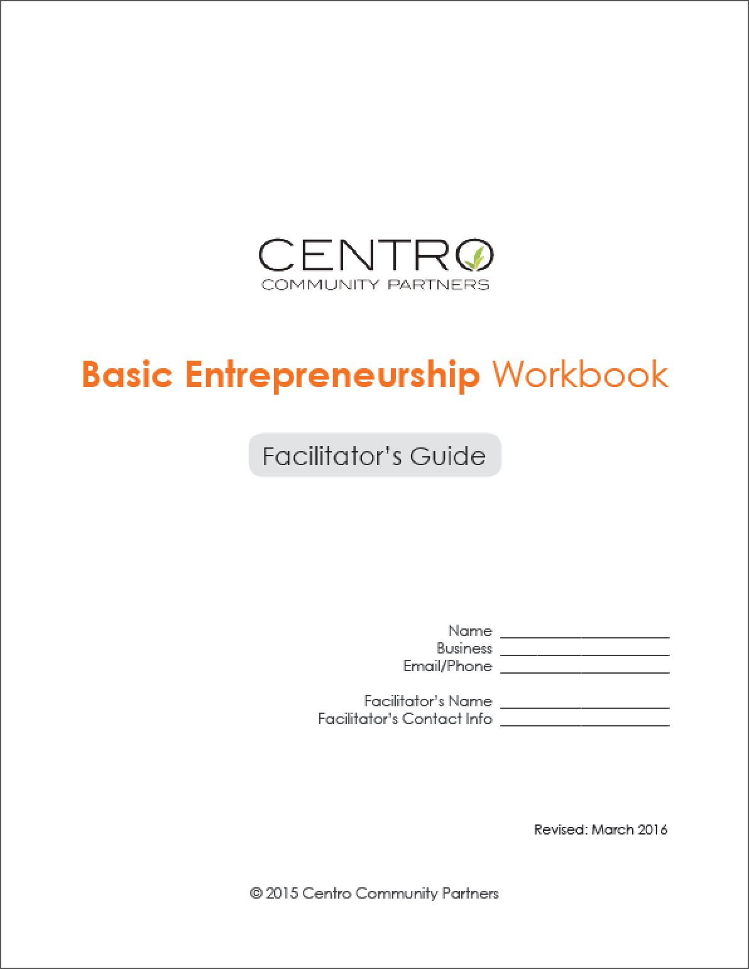
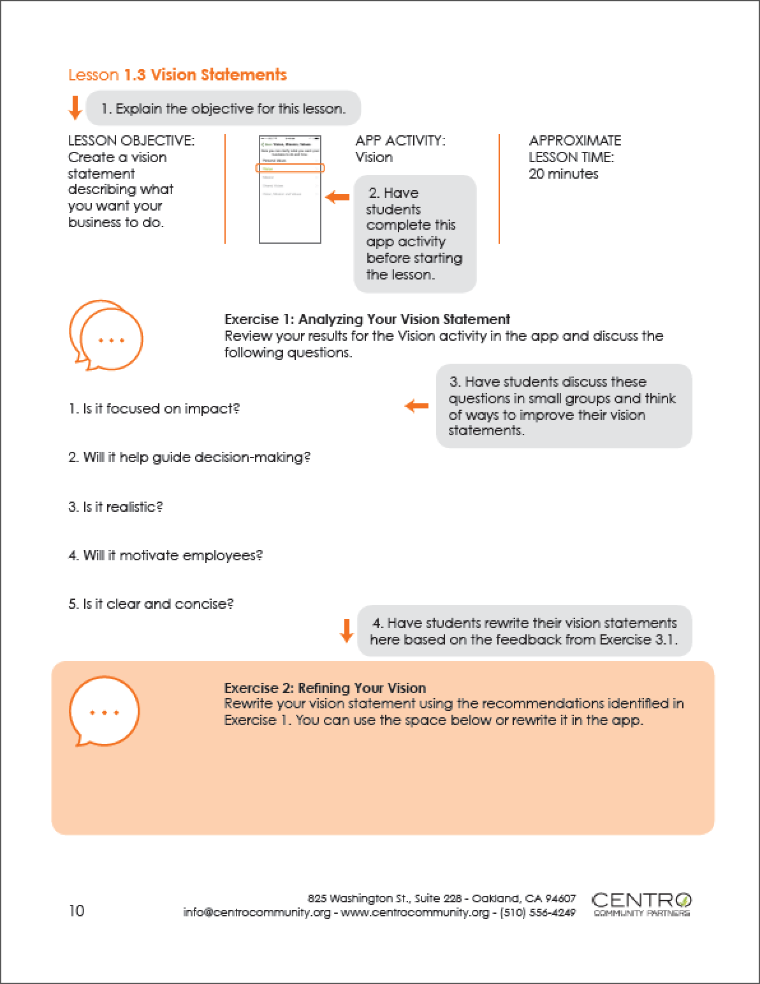
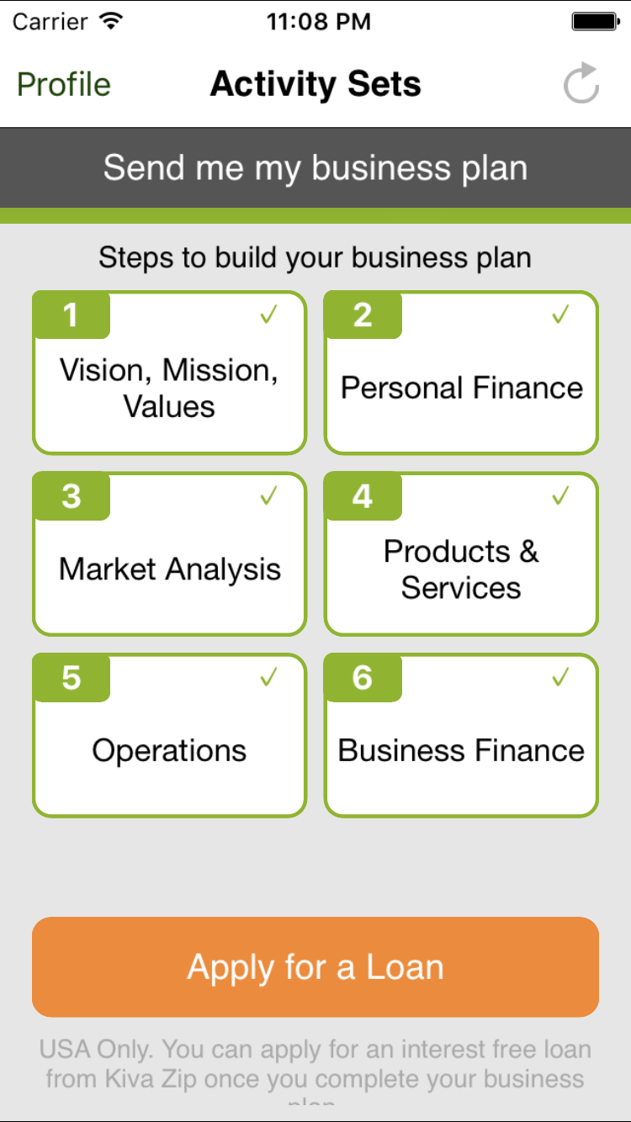
Turnkey Curriculum & Facilitator Guide

Slide 33
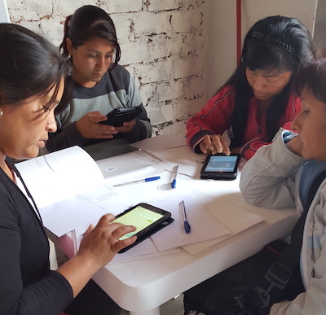
Basic Entrepreneurship Education Suite Ready-to-use quality entrepreneurship education for organizations supporting aspiring and current small business owners who lack any business education or experience. CentroCommunity.org/Entrepreneurship-Suite

Slide 34
Simple steps that
anyone can follow
Anyone with access
to a mobile device
Free app & affordable support for providers
Connections to
support & capital

Slide 35
Centro Business Planning App
www.centro-mobile.org

