Slide 1
Platform Cooperatives

Slide 3
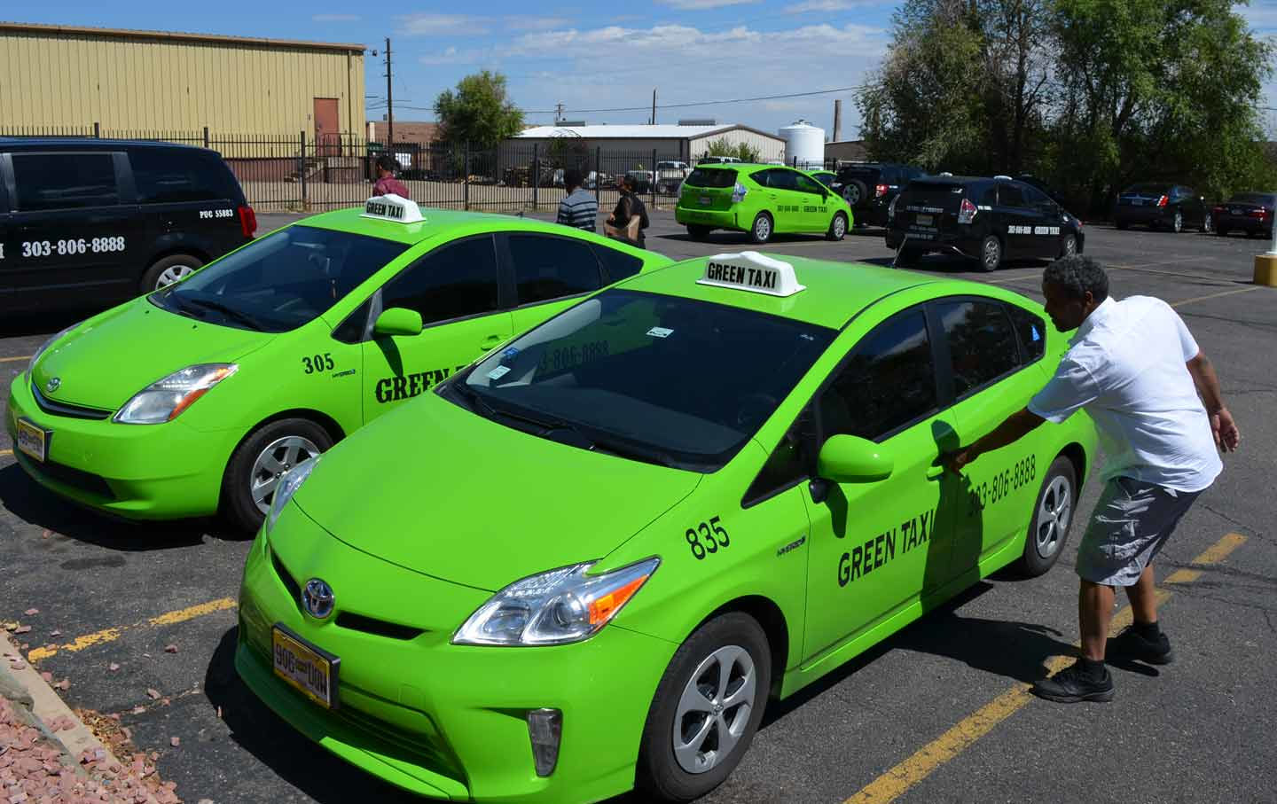

Slide 5
Resources
http://www.shareable.net/blog/a-shareable-explainer-what-is-a-platform-co-op
Join our newsletter here: http://www.shareable.net/newsletter
Twitter @Shareable / Facebook.com/Shareable

