Slide 1
Changing Face of Business Support
Lindsey Crumbaugh,
Samaschool
Access to the gig economy for
disadvantaged populations

Slide 2
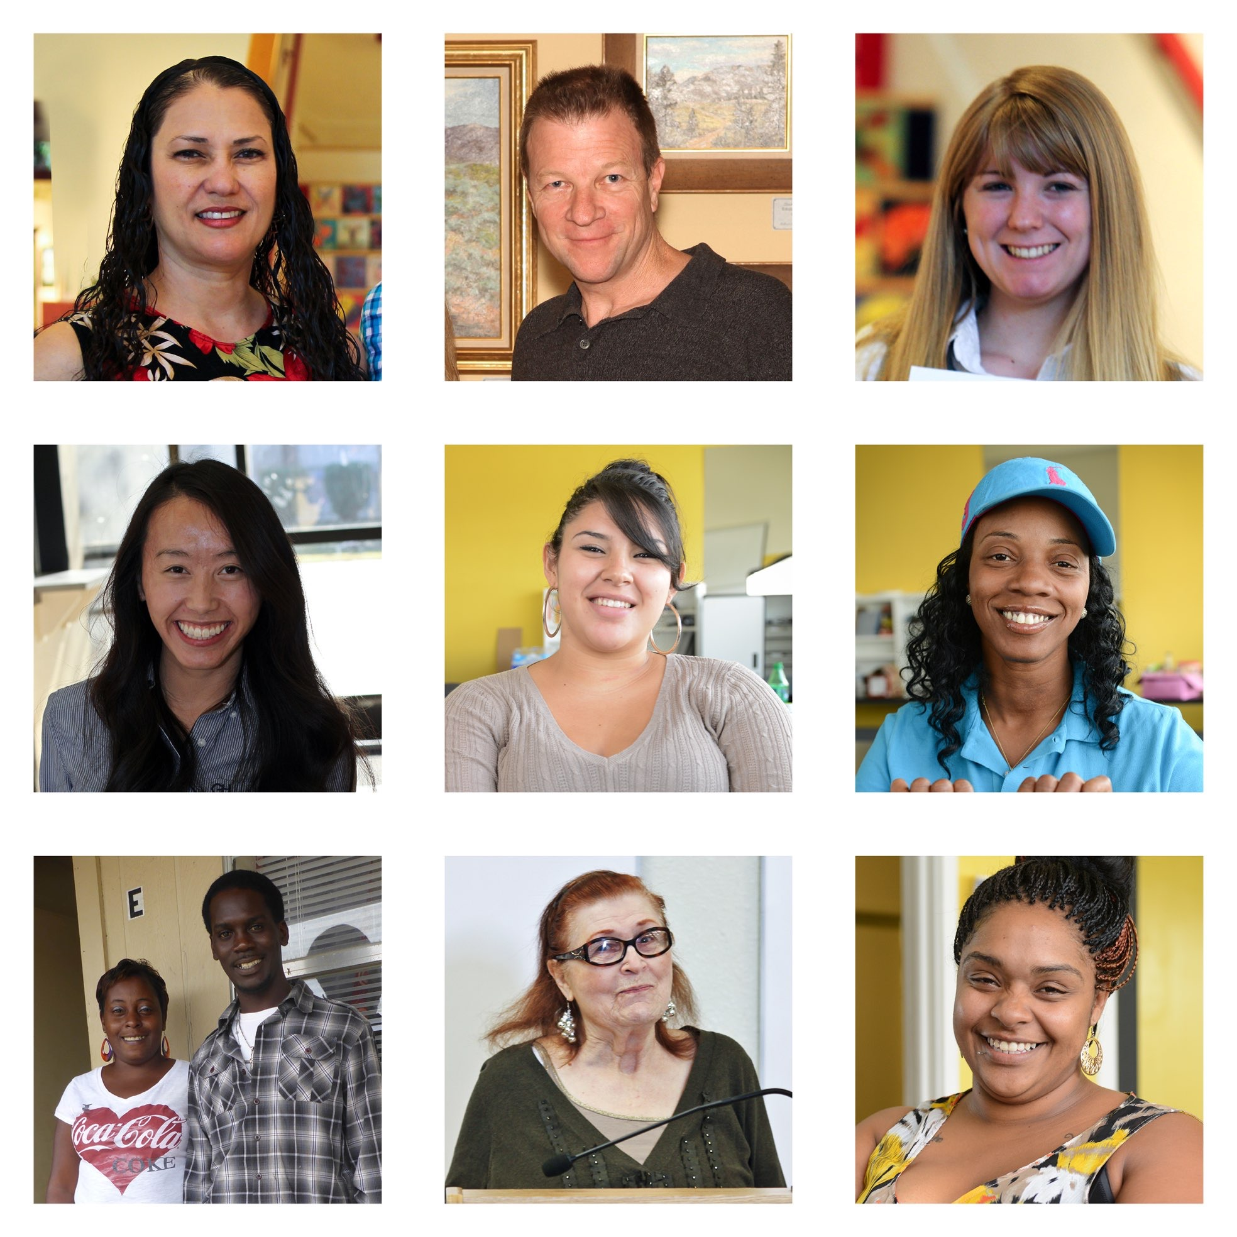
The New Entrepreneur

Slide 3
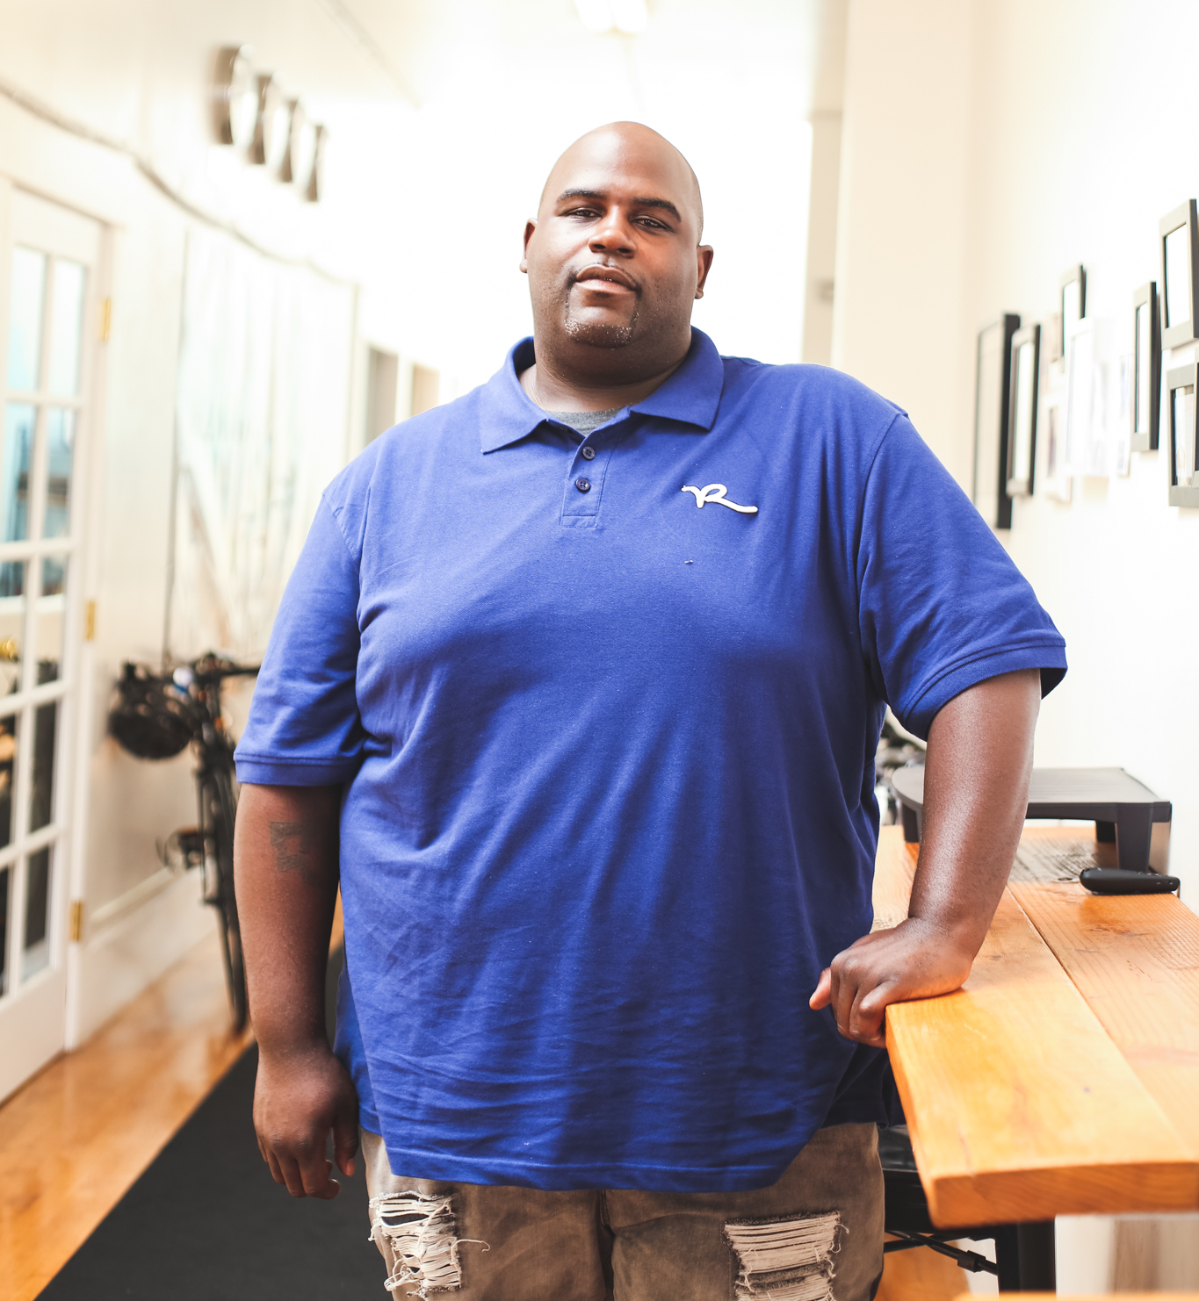
LAVELL
Automotive Services
Errand & Delivery Services
Event Coordination
Administrative Assistance
Marketing
Moving
Packaging & Shipping
Senior Support
Shopping
Product User Testing

Slide 5
GIG WORK
INDEPENDENT WORK
ALTERNATIVE WORK
FREELANCE WORK

Slide 6
ENTREPRENEUR

Slide 7
“ALL OF THE NET
EMPLOYMENT GROWTH IN THE U.S. ECONOMY FROM 2005 TO 2015 APPEARS TO HAVE OCCURRED IN ALTERNATIVE WORK ARRANGEMENTS.”
- KATZ & KRUEGER

Slide 9
About us:
Samaschool moves people out of poverty by providing low-income populations with training access to independent (“gig”) work opportunities.
Why this matters:
(Re)enter the workforce
(Re)build experience
(Re)build confidence
Access to income
Increase economic security

Slide 10
GIG ECONOMY
=
NEW LAUNCHPAD FOR ENTREPRENEURS

Slide 11
LOWER CUSOMTER ACQUISITION COSTS
BUILD A BRAND
LOWER CAPITAL COSTS
FINANCIAL WHEREWITHAL

Slide 12
DIGITAL PRESENCE
CUSTOMER ACQUISITION
PRICING
FINANCIAL TRACK RECORD

Slide 13
NEW MVP…
AND BEYOND?

Slide 14
THE NEW ENTERPRENEUR

